Slide 1
Learning with Kernels
CS771: Introduction to Machine Learning
Purushottam Kar

Slide 2
Non-linear Learning
These are learning techniques that involve non-linear models
Classifiers with non-linear decision boundaries
Regressors that predicts the label using non-linear functions
Dim-redn that reveal if data was lying on a low-dim curved surface
We have actually seen a few non-linear learning techniques already
kNN, learning with multiple prototypes are all capable of learning non-linear decision boundaries, non-linear functions etc
Also saw generalized linear models in the last class
These are nice and valuable but much more powerful methods exist
Will study two such methods – kernel learning and deep learning
Start with kernel learning

Slide 3
When should I use kernels?
Kernel methods are a good option to try whenever linear models do a poor job on our data
A non-linear classifier is needed
Linear classifier fits excellently!
All linear classifiers would do horribly!
Even with a few outliers, a linear classifier still fits decently

Slide 4


When should I use kernels?
Kernel methods are a good option to try whenever linear models do a poor job on our data
All linear regressors would do horribly!
A non-linear regressor is needed
Linear regressor fits excellently!
Even with some noise, linear regressor still fits very well!

Slide 5
When should I use kernels?
Kernel methods are a good option to try whenever linear models do a poor job on our data
However, k-means always produces linear cluster assignment boundaries
Non-linear cluster assignment boundaries needed
K-means clusters data very well
K-means would do very badly

Slide 6
When should I use kernels?
Kernel methods are a good option to try whenever linear models do a poor job on our data
(P)PCA would do very well
Data does lie close to a low-dim hyperplane
PCA would do a bad reconstruction
No low-dim hyperplane approximates data well
Data actually lies close to a smooth low-dim (but non-linear) surface

Slide 7
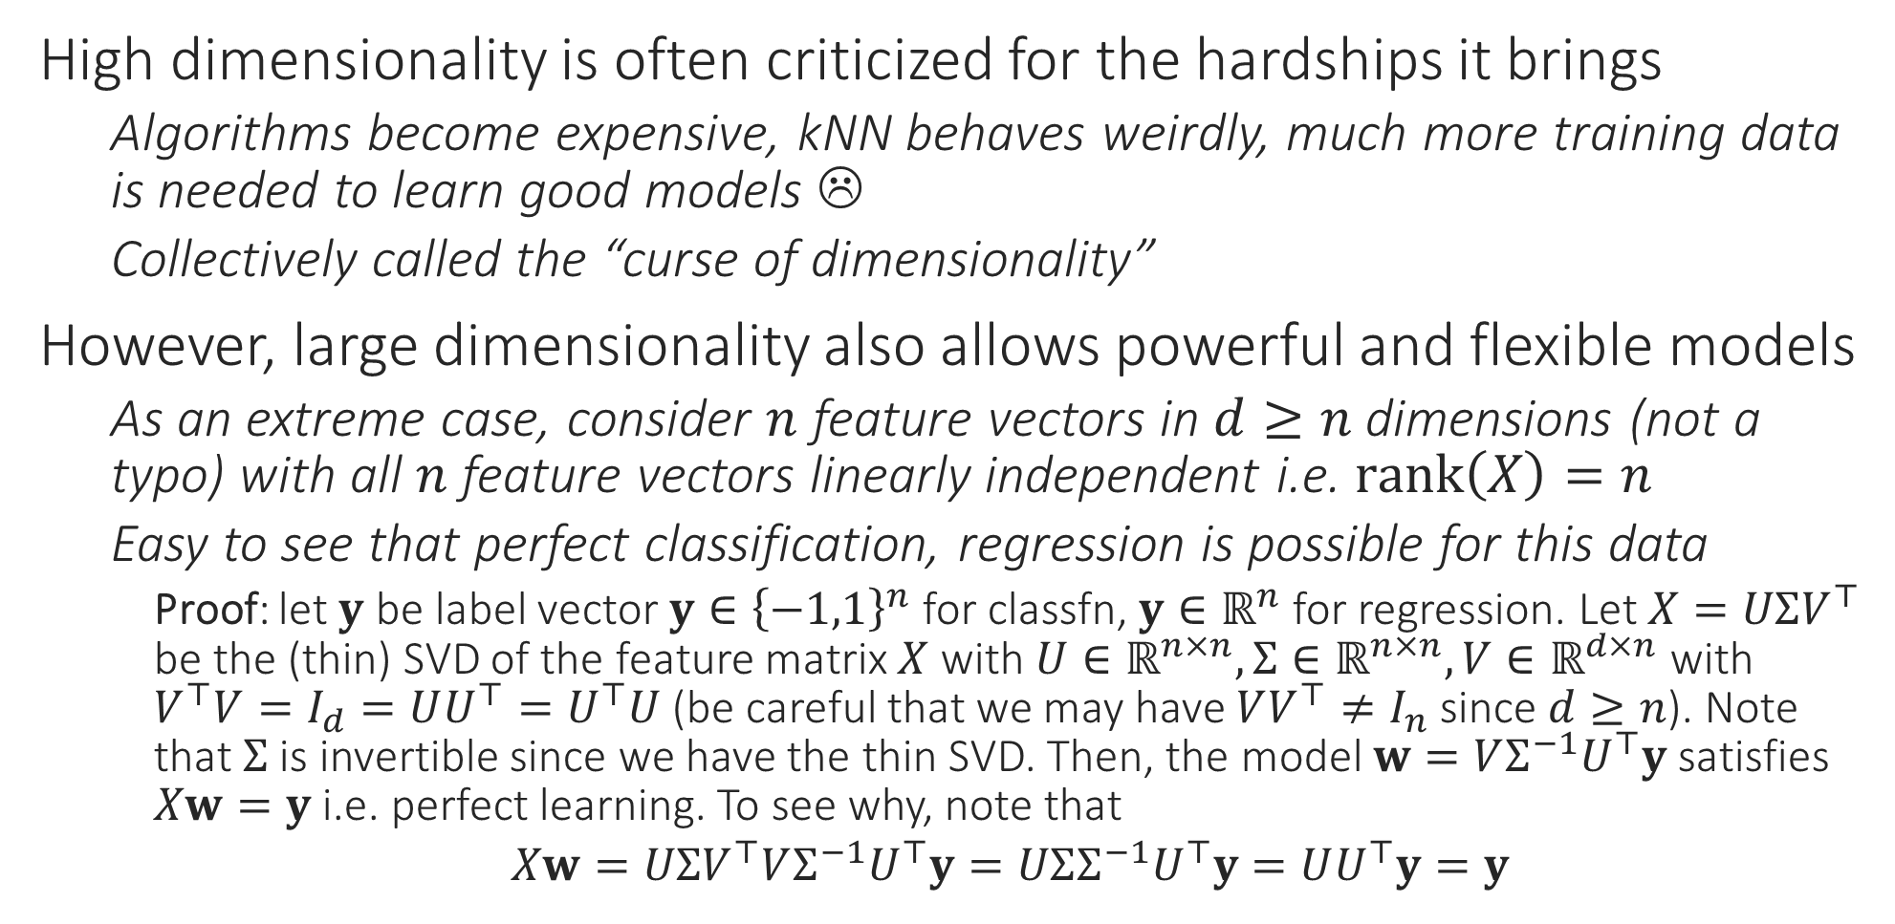
The Blessing of Dimensionality
High dimensionality is often criticized for the hardships it brings
Algorithms become expensive, kNN behaves weirdly, much more training data is needed to learn good models ☹
Collectively called the “curse of dimensionality”
However, large dimensionality also allows powerful and flexible models
As an extreme case, consider $n$ feature vectors in $d≥n$ dimensions (not a typo) with all $n$ feature vectors linearly independent i.e. $rank\left(X\right)=n$
Easy to see that perfect classification, regression is possible for this data
Proof: let $y$ be label vector $y∈{\left\{−1,1\right\}}^{n}$ for classfn, $y∈ℝ^{n}$ for regression. Let $X=UΣV^{⊤}$ be the (thin) SVD of the feature matrix $X$ with $U∈ℝ^{n×n},Σ∈ℝ^{n×n},V∈ℝ^{d×n}$ with $V^{⊤}V=I_{d}=UU^{⊤}=U^{⊤}U$ (be careful that we may have $VV^{⊤}≠I_{n}$ since $d≥n$). Note that $Σ$ is invertible since we have the thin SVD. Then, the model $w=VΣ^{−1}U^{⊤}y$ satisfies $Xw=y$ i.e. perfect learning. To see why, note that
$Xw=UΣV^{⊤}VΣ^{−1}U^{⊤}y=UΣΣ^{−1}U^{⊤}y=UU^{⊤}y=y$

Slide 8

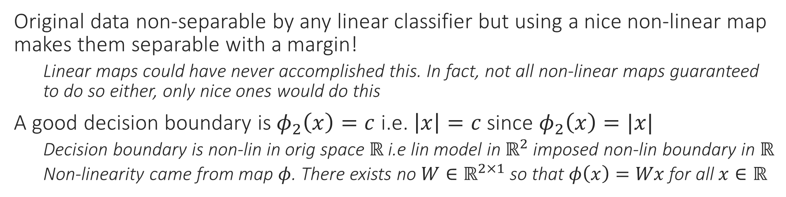
Non-linear Classification
Original data non-separable by any linear classifier but using a nice non-linear map makes them separable with a margin!
Linear maps could have never accomplished this. In fact, not all non-linear maps guaranteed to do so either, only nice ones would do this
A good decision boundary is $φ_{2}\left(x\right)=c$ i.e. $\left|x\right|=c$ since $φ_{2}\left(x\right)=|x|$
Decision boundary is non-lin in orig space $ℝ$ i.e lin model in $ℝ^{2}$ imposed non-lin boundary in $ℝ$
Non-linearity came from map $φ$. There exists no $W∈ℝ^{2×1}$ so that $φ\left(x\right)=Wx$ for all $x∈ℝ$

Slide 9
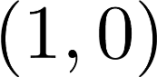
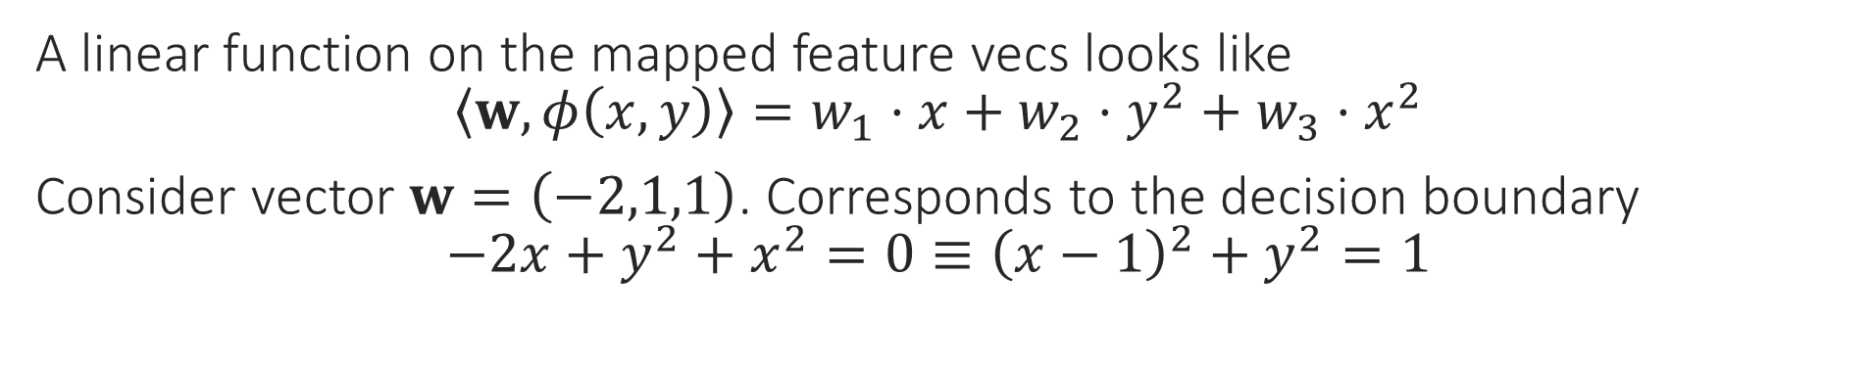
Non-linear Classification
A linear function on the mapped feature vecs looks like $\left\langle w,φ\left(x,y\right)\right\rangle =w_{1}⋅x+w_{2}⋅y^{2}+w_{3}⋅x^{2}$
Consider vector $w=\left(−2,1,1\right)$. Corresponds to the decision boundary $−2x+y^{2}+x^{2}=0≡{\left(x−1\right)}^{2}+y^{2}=1$

Slide 10
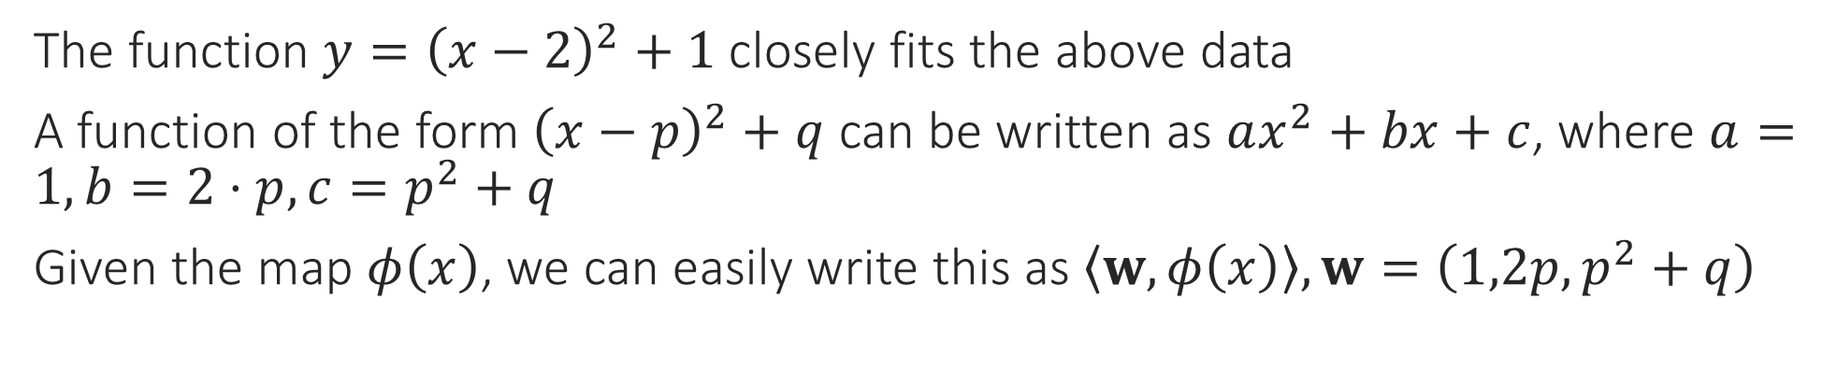
Non-linear Regression
The function $y={\left(x−2\right)}^{2}+1$ closely fits the above data
A function of the form ${\left(x−p\right)}^{2}+q$ can be written as $ax^{2}+bx+c$, where $a=1,b=2⋅p,c=p^{2}+q$
Given the map $φ\left(x\right)$, we can easily write this as $\left\langle w,φ\left(x\right)\right\rangle ,w=\left(1,2p,p^{2}+q\right)$

Slide 11
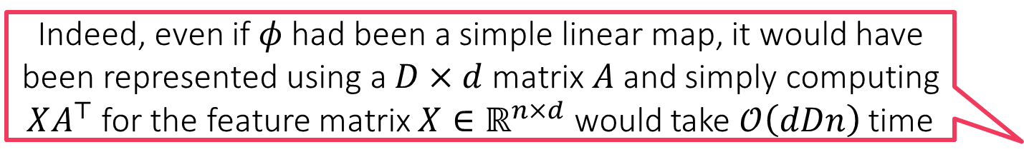
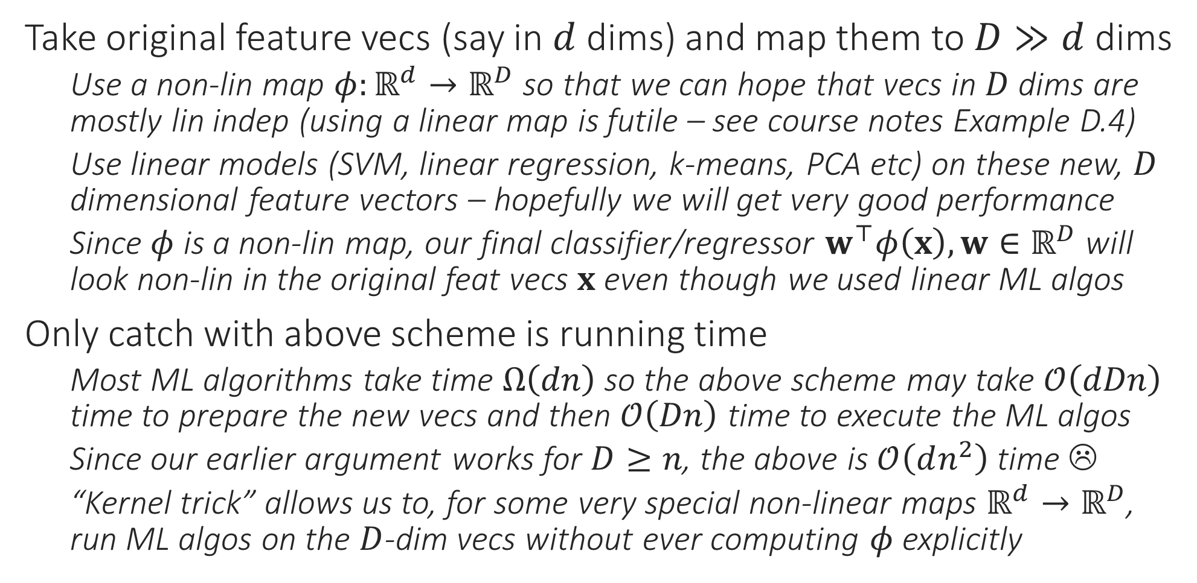
The Kernel Trick
Take original feature vecs (say in $d$ dims) and map them to $D≫d$ dims
Use a non-lin map $φ:ℝ^{d}→ℝ^{D}$ so that we can hope that vecs in $D$ dims are mostly lin indep (using a linear map is futile – see course notes Example D.4)
Use linear models (SVM, linear regression, k-means, PCA etc) on these new, $D$ dimensional feature vectors – hopefully we will get very good performance
Since $φ$ is a non-lin map, our final classifier/regressor $w^{⊤}φ\left(x\right),w∈ℝ^{D}$ will look non-lin in the original feat vecs $x$ even though we used linear ML algos
Only catch with above scheme is running time
Most ML algorithms take time $Ω\left(dn\right)$ so the above scheme may take $𝒪\left(dDn\right)$ time to prepare the new vecs and then $𝒪\left(Dn\right)$ time to execute the ML algos
Since our earlier argument works for $D≥n$, the above is $𝒪\left(dn^{2}\right)$ time ☹
“Kernel trick” allows us to, for some very special non-linear maps $ℝ^{d}→ℝ^{D}$, run ML algos on the $D$-dim vecs without ever computing $φ$explicitly
Indeed, even if $φ$ had been a simple linear map, it would have been represented using a $D×d$ matrix $A$ and simply computing $XA^{⊤}$ for the feature matrix $X∈ℝ^{n×d}$ would take $𝒪\left(dDn\right)$ time

Slide 12
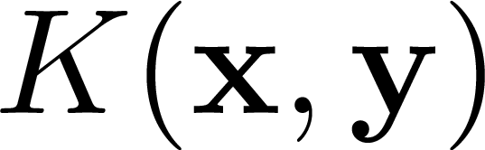
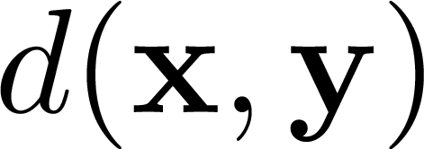
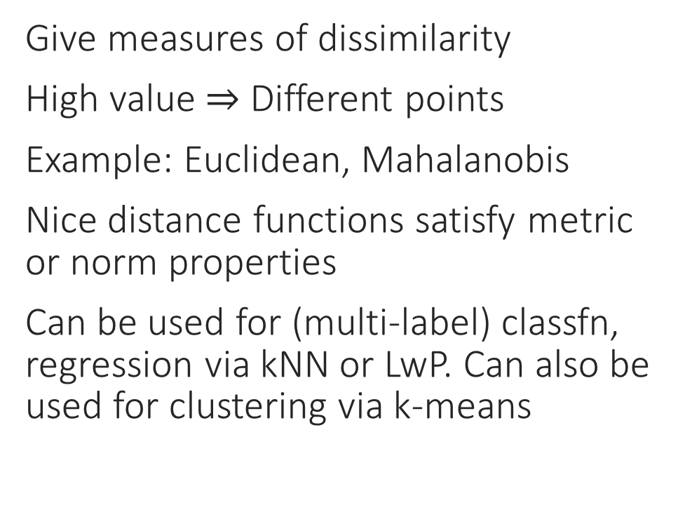
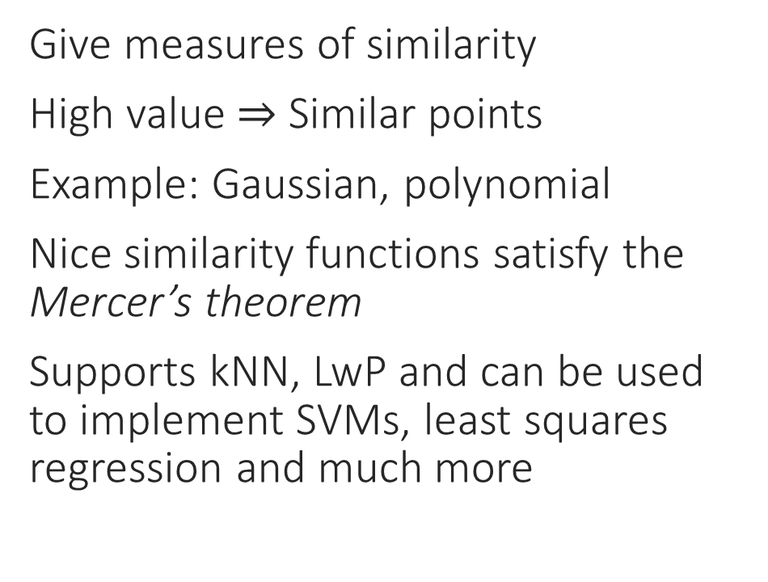
Kernels vs Distance Measures
Kernels
Distance measures
Give measures of similarity
High value $⇒$ Similar points
Example: Gaussian, polynomial
Nice similarity functions satisfy the Mercer’s theorem
Supports kNN, LwP and can be used to implement SVMs, least squares regression and much more
Give measures of dissimilarity
High value $⇒$ Different points
Example: Euclidean, Mahalanobis
Nice distance functions satisfy metric or norm properties
Can be used for (multi-label) classfn, regression via kNN or LwP. Can also be used for clustering via k-means

Slide 13

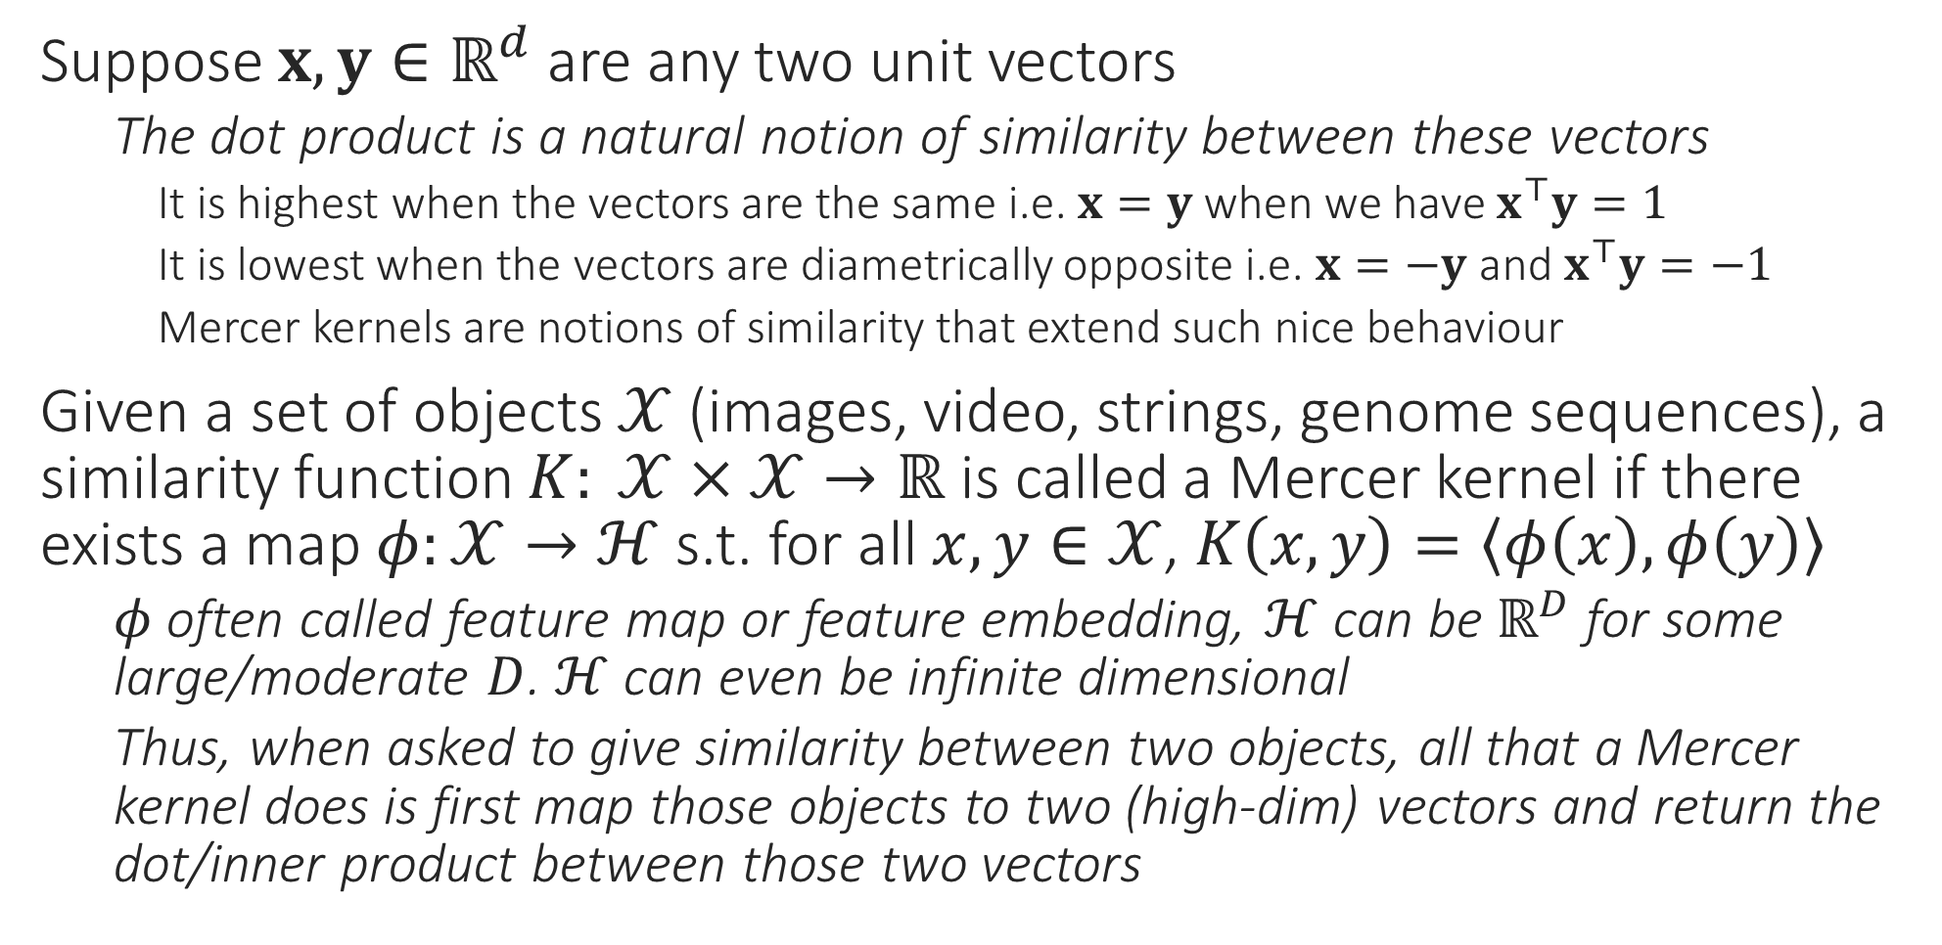
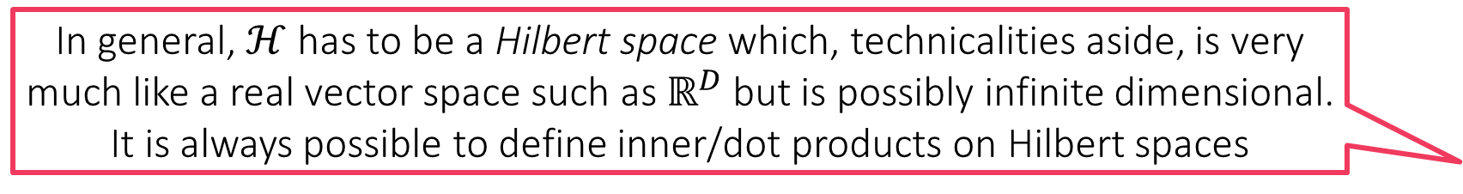
Mercer Kernels
In general, $ℋ$ has to be a Hilbert space which, technicalities aside, is very much like a real vector space such as $ℝ^{D}$ but is possibly infinite dimensional. It is always possible to define inner/dot products on Hilbert spaces
Suppose $x,y∈ℝ^{d}$ are any two unit vectors
The dot product is a natural notion of similarity between these vectors
It is highest when the vectors are the same i.e. $x=y$ when we have $x^{⊤}y=1$
It is lowest when the vectors are diametrically opposite i.e. $x=−y$ and $x^{⊤}y=−1$
Mercer kernels are notions of similarity that extend such nice behaviour
Given a set of objects $𝒳$ (images, video, strings, genome sequences), a similarity function $K: 𝒳×𝒳→ℝ$ is called a Mercer kernel if there exists a map $φ:𝒳→ℋ$ s.t. for all $x,y∈𝒳$, $K\left(x,y\right)=\left\langle φ\left(x\right),φ\left(y\right)\right\rangle$
$φ$ often called feature map or feature embedding, $ℋ$ can be $ℝ^{D}$ for some large/moderate $D$. $ℋ$ can even be infinite dimensional
Thus, when asked to give similarity between two objects, all that a Mercer kernel does is first map those objects to two (high-dim) vectors and return the dot/inner product between those two vectors

Slide 14

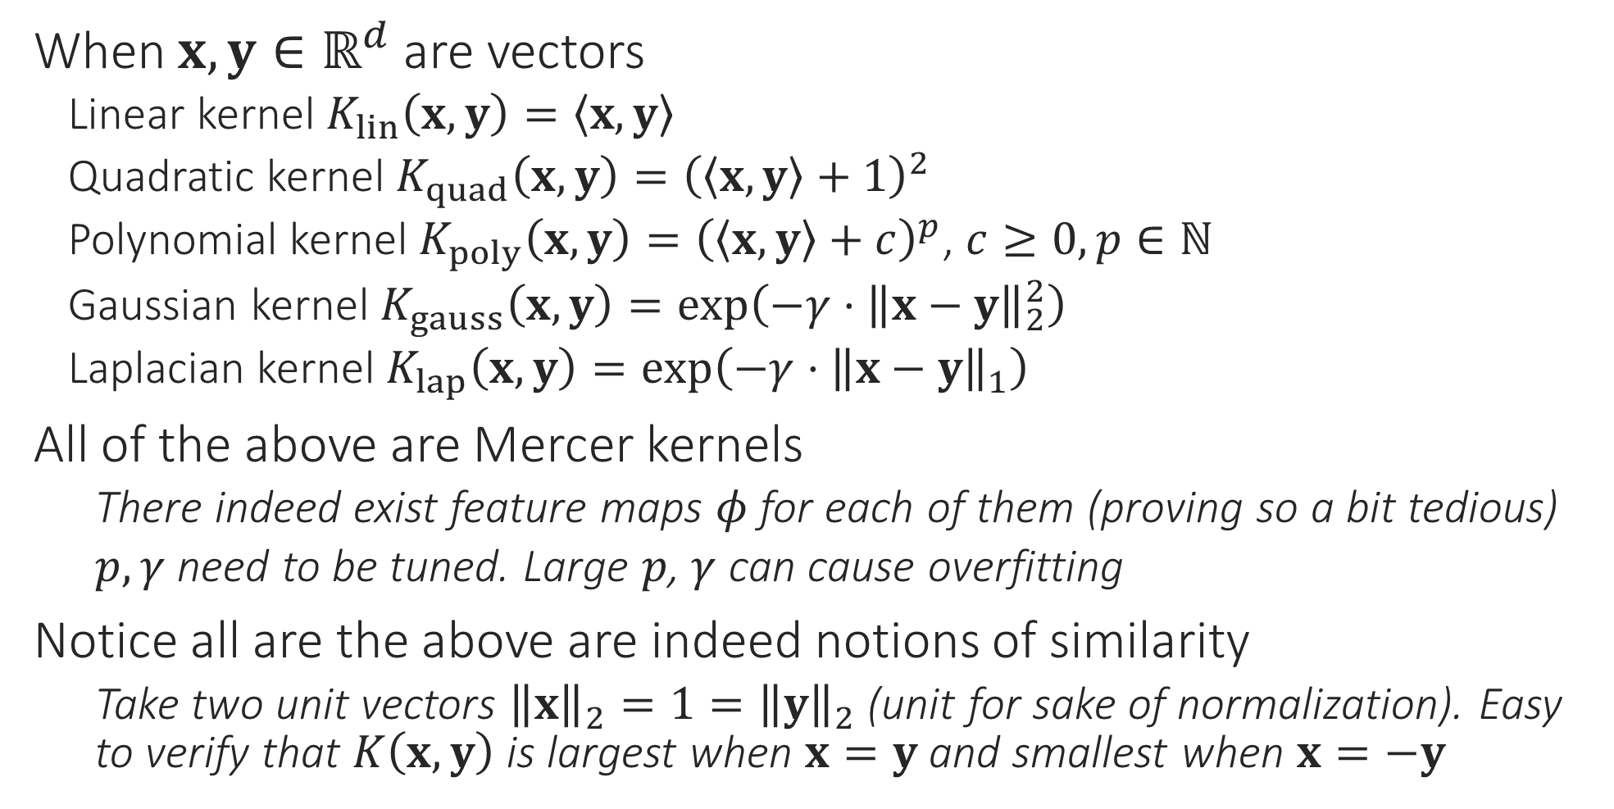
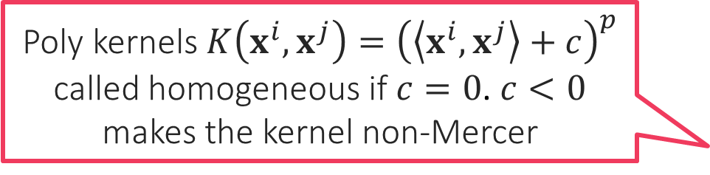
Examples of Kernels
Poly kernels $K\left(x^{i},x^{j}\right)={\left(\left\langle x^{i},x^{j}\right\rangle +c\right)}^{p}$ called homogeneous if $c=0$. $c<0$ makes the kernel non-Mercer
When $x,y∈ℝ^{d}$ are vectors
Linear kernel $K_{lin}\left(x,y\right)=\left\langle x,y\right\rangle$
Quadratic kernel $K_{quad}\left(x,y\right)={\left(\left\langle x,y\right\rangle +1\right)}^{2}$
Polynomial kernel $K_{poly}\left(x,y\right)={\left(\left\langle x,y\right\rangle +c\right)}^{p}$, $c≥0,p∈ℕ$
Gaussian kernel $K_{gauss}\left(x,y\right)=\exp\left(−γ⋅{\left\|x−y\right\|}_{2}^{2}\right)$
Laplacian kernel $K_{lap}\left(x,y\right)=\exp\left(−γ⋅{\left\|x−y\right\|}_{1}\right)$
All of the above are Mercer kernels
There indeed exist feature maps $φ$ for each of them (proving so a bit tedious)
$p,γ$ need to be tuned. Large $p$, $γ$ can cause overfitting
Notice all are the above are indeed notions of similarity
Take two unit vectors ${\left\|x\right\|}_{2}=1={\left\|y\right\|}_{2}$ (unit for sake of normalization). Easy to verify that $K\left(x,y\right)$ is largest when $x=y$ and smallest when $x=−y$

Slide 15
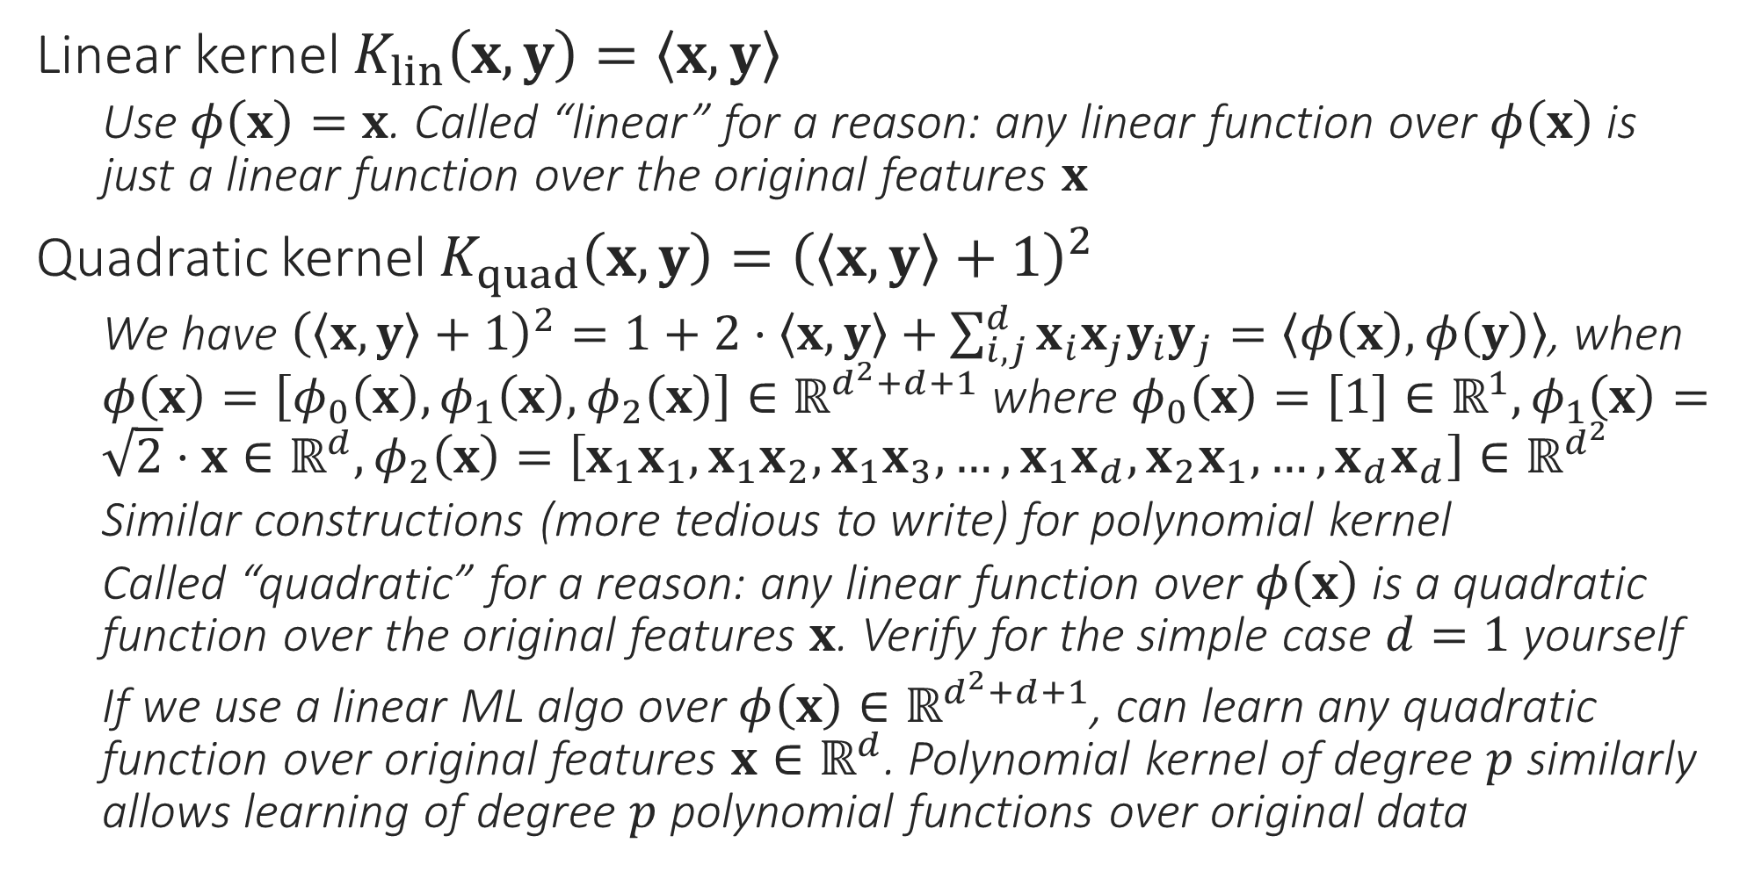
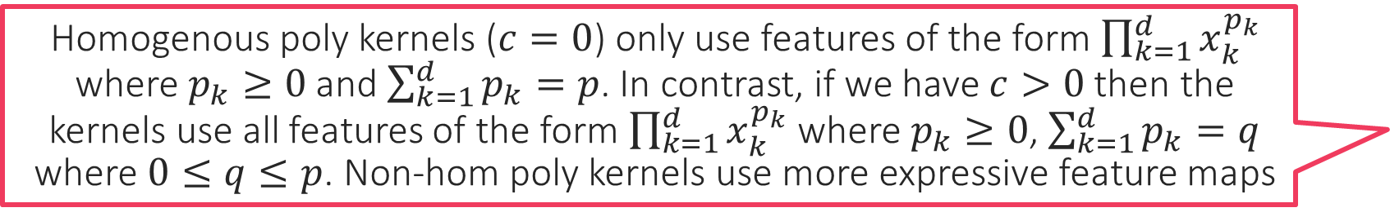
Mercer Kernel Feature Maps
Homogenous poly kernels ($c=0$) only use features of the form $\prod_{k=1}^{d}{x_{k}^{p_{k}}}$ where $p_{k}≥0$ and $\sum_{k=1}^{d}{p_{k}}=p$. In contrast, if we have $c>0$ then the kernels use all features of the form $\prod_{k=1}^{d}{x_{k}^{p_{k}}}$ where $p_{k}≥0$, $\sum_{k=1}^{d}{p_{k}}=q$ where $0≤q≤p$. Non-hom poly kernels use more expressive feature maps
Linear kernel $K_{lin}\left(x,y\right)=\left\langle x,y\right\rangle$
Use $φ\left(x\right)=x$. Called “linear” for a reason: any linear function over $φ\left(x\right)$ is just a linear function over the original features $x$
Quadratic kernel $K_{quad}\left(x,y\right)={\left(\left\langle x,y\right\rangle +1\right)}^{2}$
We have ${\left(\left\langle x,y\right\rangle +1\right)}^{2}=1+2⋅\left\langle x,y\right\rangle +\sum_{i,j}^{d}{x_{i}x_{j}y_{i}y_{j}}=\left\langle φ\left(x\right),φ\left(y\right)\right\rangle$, when $φ\left(x\right)=\left[φ_{0}\left(x\right),φ_{1}\left(x\right),φ_{2}\left(x\right)\right]∈ℝ^{d^{2}+d+1}$ where $φ_{0}\left(x\right)=\left[1\right]∈ℝ^{1},φ_{1}\left(x\right)=\sqrt{2}⋅x∈ℝ^{d},φ_{2}\left(x\right)=\left[x_{1}x_{1},x_{1}x_{2},x_{1}x_{3},…,x_{1}x_{d},x_{2}x_{1},…,x_{d}x_{d}\right]∈ℝ^{d^{2}}$
Similar constructions (more tedious to write) for polynomial kernel
Called “quadratic” for a reason: any linear function over $φ\left(x\right)$ is a quadratic function over the original features $x$. Verify for the simple case $d=1$ yourself
If we use a linear ML algo over $φ\left(x\right)∈ℝ^{d^{2}+d+1}$, can learn any quadratic function over original features $x∈ℝ^{d}$. Polynomial kernel of degree $p$ similarly allows learning of degree $p$ polynomial functions over original data

Slide 16

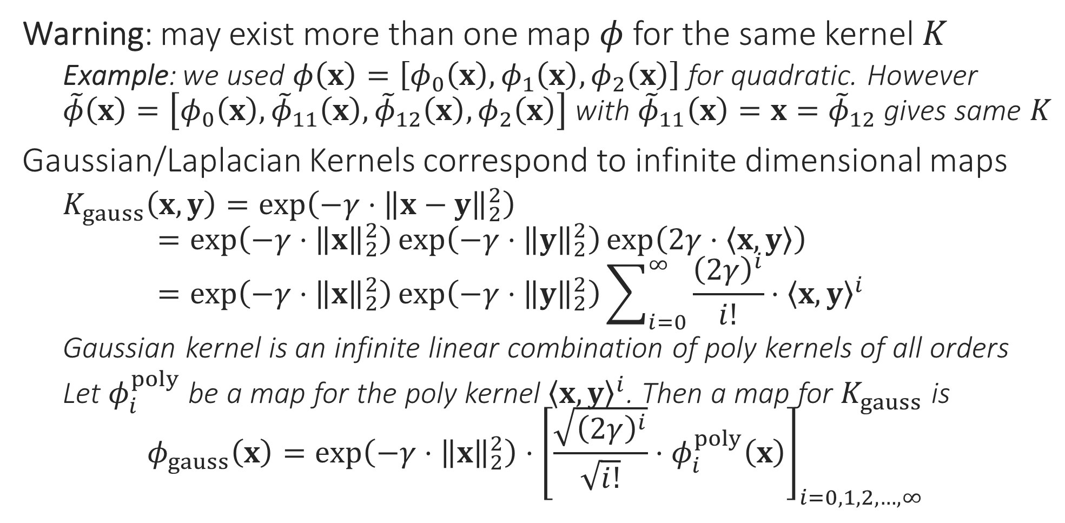
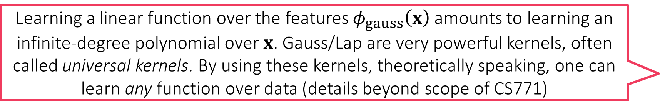
Mercer Kernel Feature Maps
Learning a linear function over the features $φ_{gauss}\left(x\right)$ amounts to learning an infinite-degree polynomial over $x$. Gauss/Lap are very powerful kernels, often called universal kernels. By using these kernels, theoretically speaking, one can learn any function over data (details beyond scope of CS771)
Warning: may exist more than one map $φ$ for the same kernel $K$
Example: we used $φ\left(x\right)=\left[φ_{0}\left(x\right),φ_{1}\left(x\right),φ_{2}\left(x\right)\right]$ for quadratic. However $\tilde{φ}\left(x\right)=\left[φ_{0}\left(x\right),{\tilde{φ}}_{11}\left(x\right),{\tilde{φ}}_{12}\left(x\right),φ_{2}\left(x\right)\right]$ with ${\tilde{φ}}_{11}\left(x\right)=x={\tilde{φ}}_{12}$ gives same $K$
Gaussian/Laplacian Kernels correspond to infinite dimensional maps
$K_{gauss}\left(x,y\right)=\exp\left(−γ⋅{\left\|x−y\right\|}_{2}^{2}\right)$ $=\exp\left(−γ⋅{\left\|x\right\|}_{2}^{2}\right)\exp\left(−γ⋅{\left\|y\right\|}_{2}^{2}\right)\exp\left(2γ⋅\left\langle x,y\right\rangle \right)$ $=\exp\left(−γ⋅{\left\|x\right\|}_{2}^{2}\right)\exp\left(−γ⋅{\left\|y\right\|}_{2}^{2}\right)\sum_{i=0}^{∞}{\frac{{\left(2γ\right)}^{i}}{i!}⋅{\left\langle x,y\right\rangle }^{i}}$
Gaussian kernel is an infinite linear combination of poly kernels of all orders
Let $φ_{i}^{poly}$ be a map for the poly kernel ${\left\langle x,y\right\rangle }^{i}$. Then a map for $K_{gauss}$ is $φ_{gauss}\left(x\right)=\exp\left(−γ⋅{\left\|x\right\|}_{2}^{2}\right)⋅{\left[\frac{\sqrt{{\left(2γ\right)}^{i}}}{\sqrt{i!}}⋅φ_{i}^{poly}\left(x\right)\right]}_{i=0,1,2,…,∞}$

Slide 17
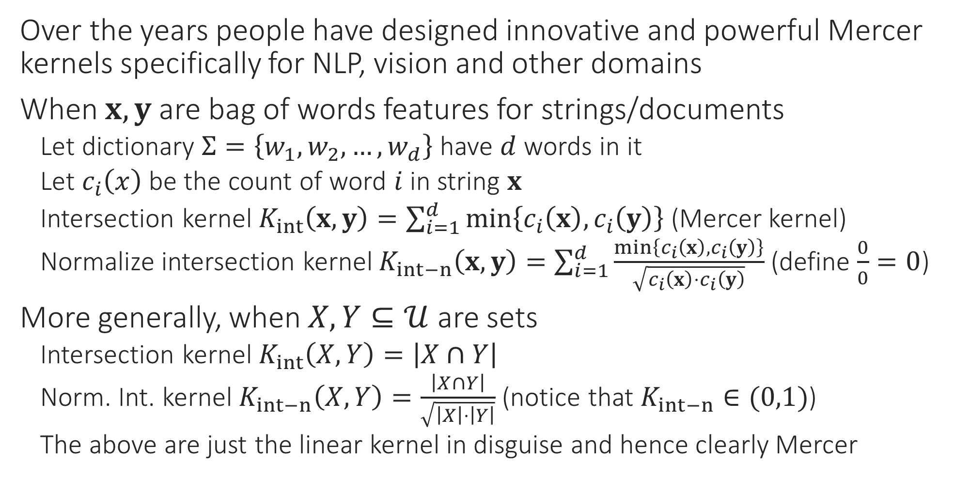
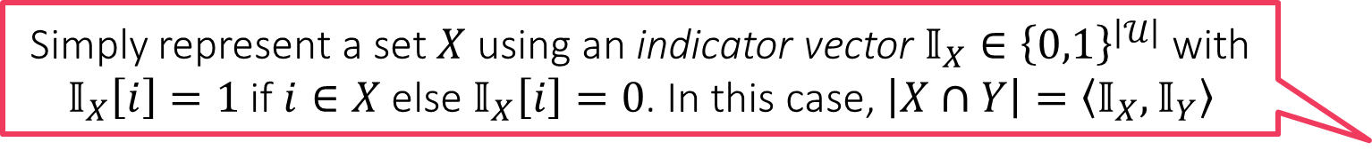
Some Domain Specific Kernels
Over the years people have designed innovative and powerful Mercer kernels specifically for NLP, vision and other domains
When $x,y$ are bag of words features for strings/documents
Let dictionary $Σ=\left\{w_{1},w_{2},…,w_{d}\right\}$ have $d$ words in it
Let $c_{i}\left(x\right)$ be the count of word $i$ in string $x$
Intersection kernel $K_{int}\left(x,y\right)=\sum_{i=1}^{d}{\min\left\{c_{i}\left(x\right),c_{i}\left(y\right)\right\}}$ (Mercer kernel)
Normalize intersection kernel $K_{int−n}\left(x,y\right)=\sum_{i=1}^{d}{\frac{\min\left\{c_{i}\left(x\right),c_{i}\left(y\right)\right\}}{\sqrt{c_{i}\left(x\right)⋅c_{i}\left(y\right)}}}$ (define $\frac{0}{0}=0$)
More generally, when $X,Y⊆𝒰$ are sets
Intersection kernel $K_{int}\left(X,Y\right)=\left|X∩Y\right|$
Norm. Int. kernel $K_{int−n}\left(X,Y\right)=\frac{\left|X∩Y\right|}{\sqrt{\left|X\right|⋅\left|Y\right|}}$ (notice that $K_{int−n}∈(0,1)$)
The above are just the linear kernel in disguise and hence clearly Mercer
Simply represent a set $X$ using an indicator vector $𝕀_{X}∈{\left\{0,1\right\}}^{\left|𝒰\right|}$ with $𝕀_{X}\left[i\right]=1$ if $i∈X$ else $𝕀_{X}\left[i\right]=0$. In this case, $\left|X∩Y\right|=\left\langle 𝕀_{X},𝕀_{Y}\right\rangle$

Slide 18
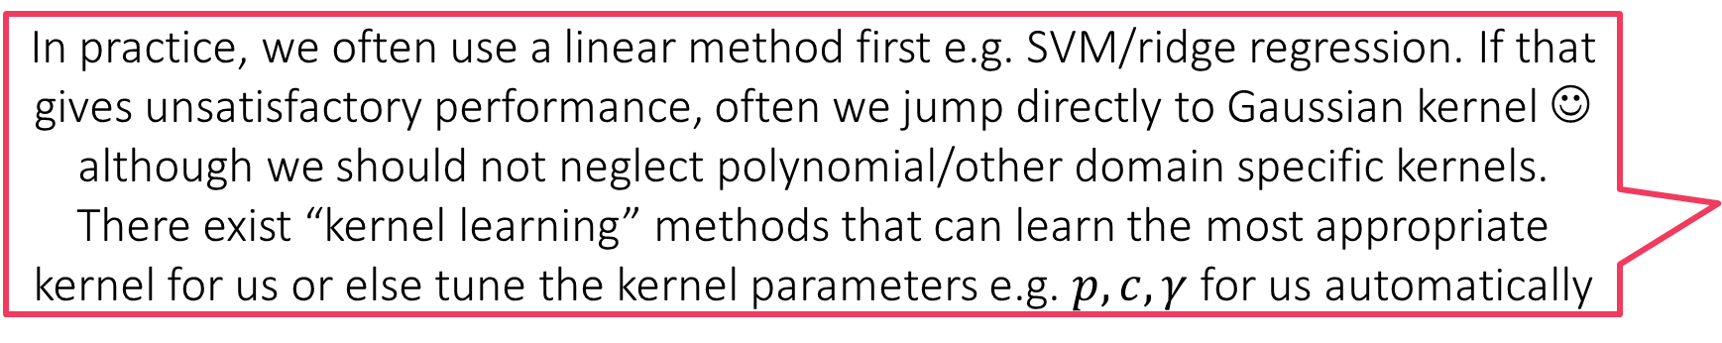
Some Domain Specific Kernels
N-gram, substring, Fisher kernels: other kernels between two strings
Random walk kernels between two graphs
Subtree, convolutional kernels between two trees
Pyramid kernel used in vision … combination of intersection kernels
In practice, we often use a linear method first e.g. SVM/ridge regression. If that gives unsatisfactory performance, often we jump directly to Gaussian kernel ☺ although we should not neglect polynomial/other domain specific kernels. There exist “kernel learning” methods that can learn the most appropriate kernel for us or else tune the kernel parameters e.g. $p,c,γ$ for us automatically

Slide 19
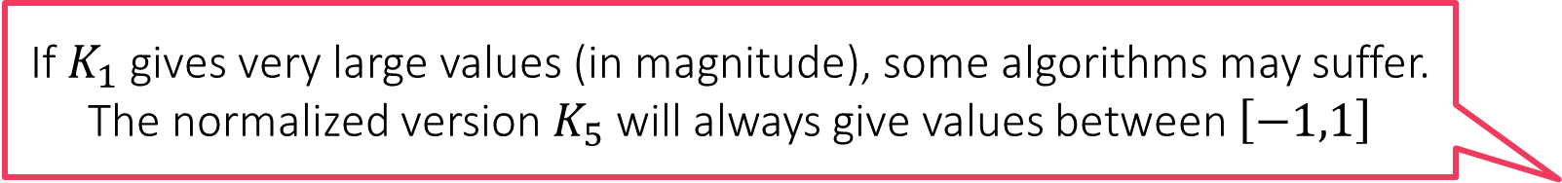
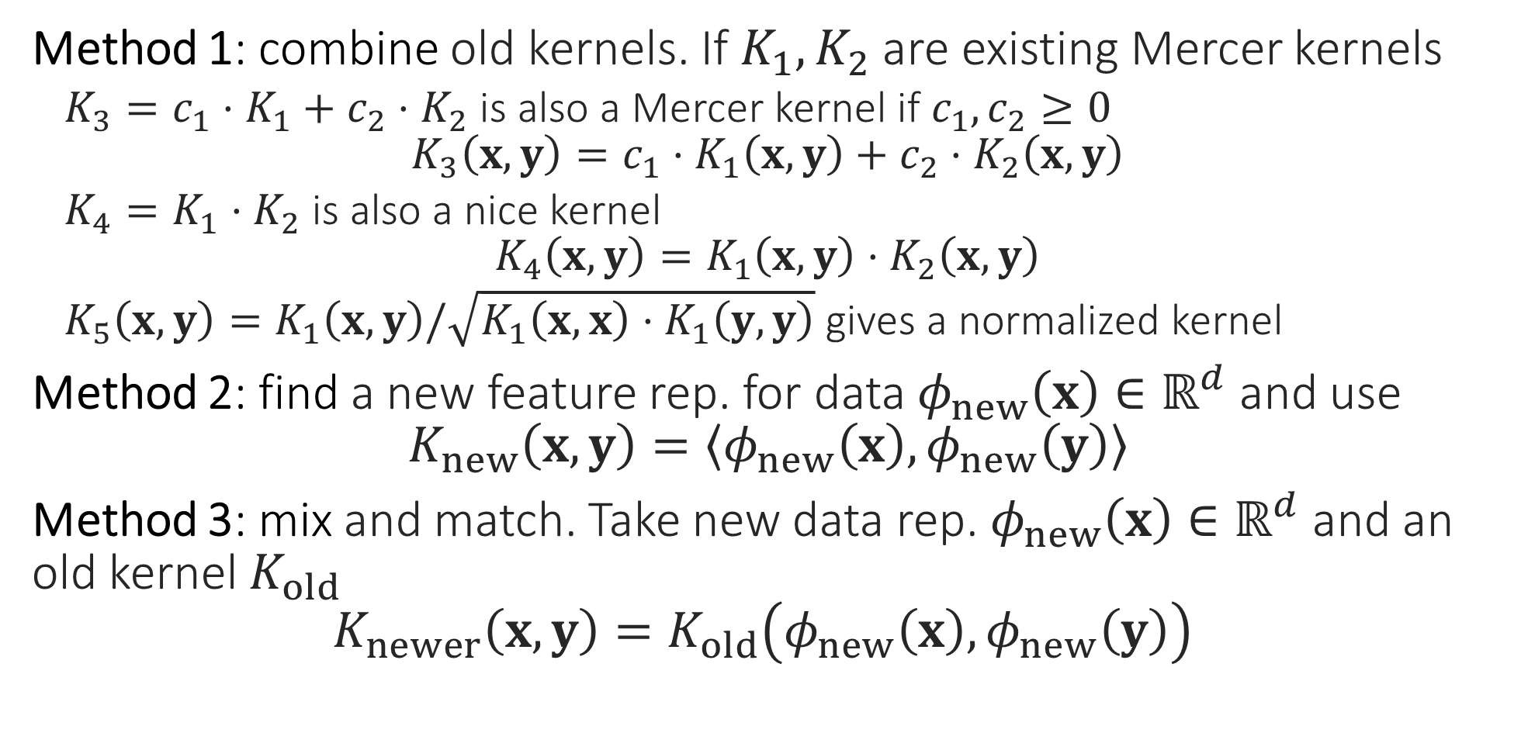
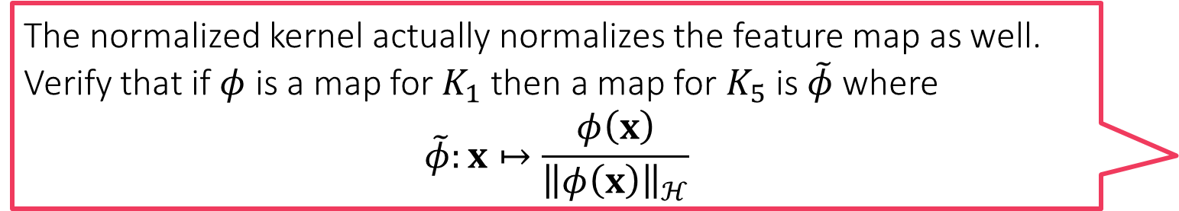
Creating New Kernels
The normalized kernel actually normalizes the feature map as well. Verify that if $φ$ is a map for $K_{1}$ then a map for $K_{5}$ is $\tilde{φ}$ where
$$\tilde{φ}:x↦\frac{φ\left(x\right)}{{\left\|φ\left(x\right)\right\|}_{ℋ}}$$
Method 1: combine old kernels. If $K_{1},K_{2}$ are existing Mercer kernels
$K_{3}=c_{1}⋅K_{1}+c_{2}⋅K_{2}$ is also a Mercer kernel if $c_{1},c_{2}≥0$ $K_{3}\left(x,y\right)=c_{1}⋅K_{1}\left(x,y\right)+c_{2}⋅K_{2}\left(x,y\right)$
$K_{4}=K_{1}⋅K_{2}$ is also a nice kernel $K_{4}\left(x,y\right)=K_{1}\left(x,y\right)⋅K_{2}\left(x,y\right)$
$K_{5}\left(x,y\right)=K_{1}\left(x,y\right)/\sqrt{K_{1}\left(x,x\right)⋅K_{1}\left(y,y\right)}$ gives a normalized kernel
Method 2: find a new feature rep. for data $φ_{new}\left(x\right)∈ℝ^{d}$ and use $K_{new}\left(x,y\right)=\left\langle φ_{new}\left(x\right),φ_{new}\left(y\right)\right\rangle$
Method 3: mix and match. Take new data rep. $φ_{new}\left(x\right)∈ℝ^{d}$ and an old kernel $K_{old}$ $K_{newer}\left(x,y\right)=K_{old}\left(φ_{new}\left(x\right),φ_{new}\left(y\right)\right)$
If $K_{1}$ gives very large values (in magnitude), some algorithms may suffer. The normalized version $K_{5}$ will always give values between $\left[−1,1\right]$

Slide 20
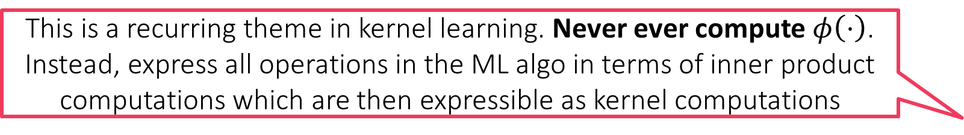
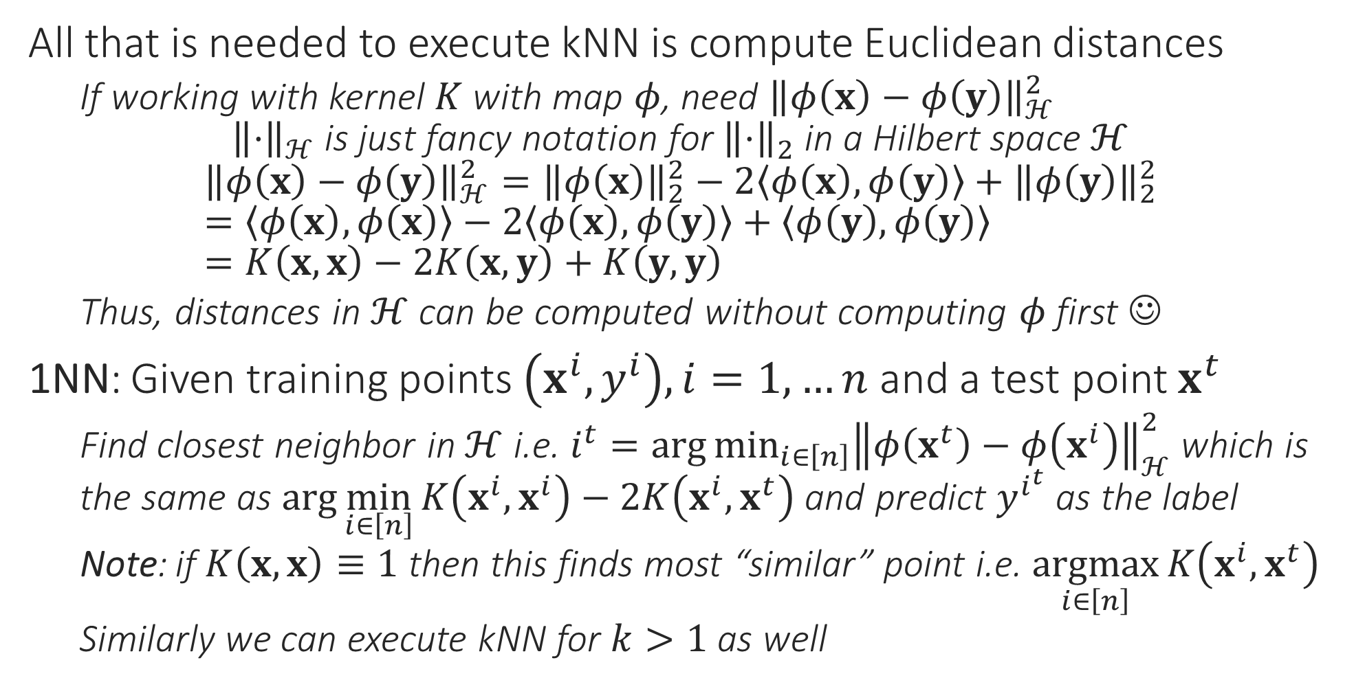
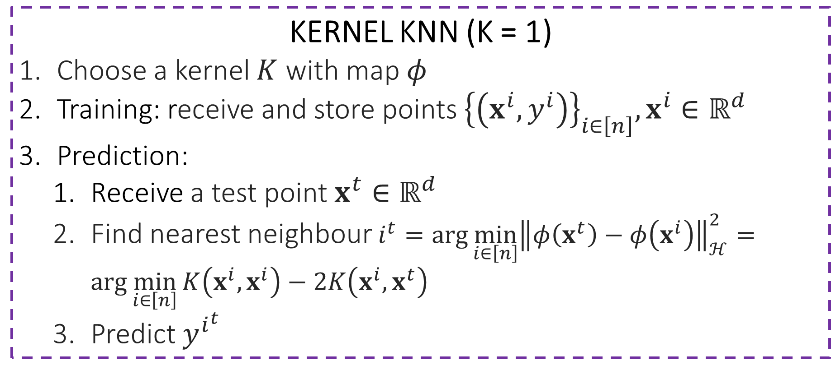
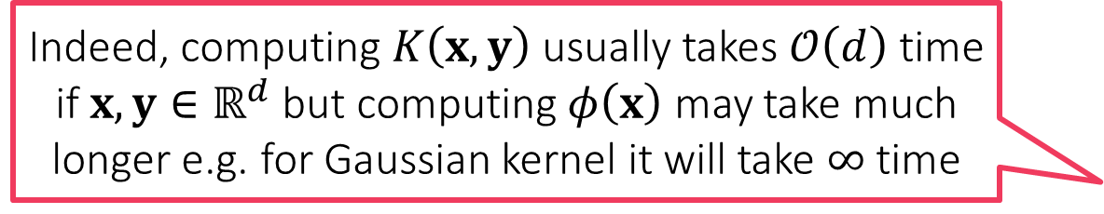
kNN with Kernels
This is a recurring theme in kernel learning. Never ever compute $φ\left(⋅\right)$. Instead, express all operations in the ML algo in terms of inner product computations which are then expressible as kernel computations
All that is needed to execute kNN is compute Euclidean distances
If working with kernel $K$ with map $φ$, need ${\left\|φ\left(x\right)−φ\left(y\right)\right\|}_{ℋ}^{2}$ ${\left\|⋅\right\|}_{ℋ} \text{is} \text{just} \text{fancy} \text{notation} \text{for} {\left\|⋅\right\|}_{2} \text{in} \text{a} \text{Hilbert} \text{space} ℋ$
$${\left\|φ\left(x\right)−φ\left(y\right)\right\|}_{ℋ}^{2}={\left\|φ\left(x\right)\right\|}_{2}^{2}−2\left\langle φ\left(x\right),φ\left(y\right)\right\rangle +{\left\|φ\left(y\right)\right\|}_{2}^{2} \\ =\left\langle φ\left(x\right),φ\left(x\right)\right\rangle −2\left\langle φ\left(x\right),φ\left(y\right)\right\rangle +\left\langle φ\left(y\right),φ\left(y\right)\right\rangle \\ =K\left(x,x\right)−2K\left(x,y\right)+K\left(y,y\right)$$
Thus, distances in $ℋ$ can be computed without computing $φ$ first ☺
1NN: Given training points $\left(x^{i},y^{i}\right),i=1,…n$ and a test point $x^{t}$
Find closest neighbor in $ℋ$ i.e. $i^{t}=\arg{\min_{i∈\left[n\right]}{{\left\|φ\left(x^{t}\right)−φ\left(x^{i}\right)\right\|}_{ℋ}^{2}}}$ which is the same as $\arg{\min_{i∈\left[n\right]}{K\left(x^{i},x^{i}\right)−2K\left(x^{i},x^{t}\right)}}$ and predict $y^{i^{t}}$ as the label
Note: if $K\left(x,x\right)≡1$ then this finds most “similar” point i.e. $\underset{i∈\left[n\right]}{argmax}{K\left(x^{i},x^{t}\right)}$
Similarly we can execute kNN for $k>1$ as well
KERNEL KNN (K = 1)
Choose a kernel $K$ with map $φ$
Training: receive and store points ${\left\{\left(x^{i},y^{i}\right)\right\}}_{i∈\left[n\right]},x^{i}∈ℝ^{d}$
Prediction:
Receive a test point $x^{t}∈ℝ^{d}$
Find nearest neighbour $i^{t}=\arg{\min_{i∈\left[n\right]}{{\left\|φ\left(x^{t}\right)−φ\left(x^{i}\right)\right\|}_{ℋ}^{2}}}=\arg{\min_{i∈\left[n\right]}{K\left(x^{i},x^{i}\right)−2K\left(x^{i},x^{t}\right)}}$
Predict $y^{i^{t}}$
Indeed, computing $K\left(x,y\right)$ usually takes $𝒪\left(d\right)$ time if $x,y∈ℝ^{d}$ but computing $φ\left(x\right)$ may take much longer e.g. for Gaussian kernel it will take $∞$ time

Slide 21
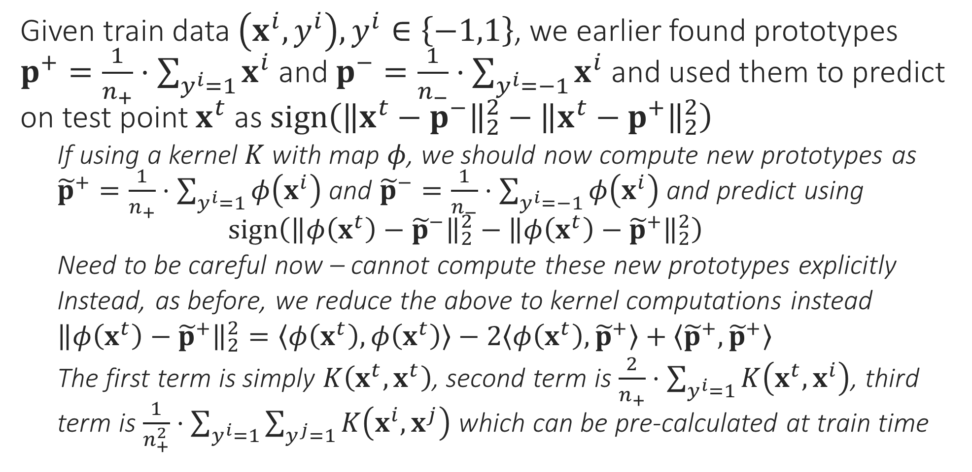
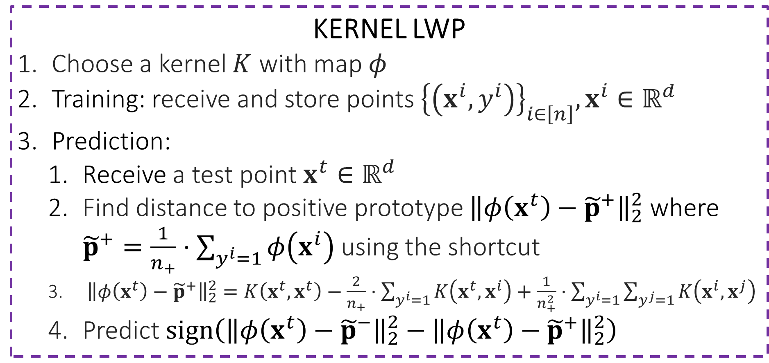
LwP with Kernels
Observe that in LwP with kernels, we now have to store entire training data whereas earlier we just had to store two prototypes. This is common in kernel learning – larger model sizes and longer prediction times
Given train data $\left(x^{i},y^{i}\right),y^{i}∈\left\{−1,1\right\}$, we earlier found prototypes $p^{+}=\frac{1}{n_{+}}⋅\sum_{y^{i}=1}{x^{i}}$ and $p^{−}=\frac{1}{n_{−}}⋅\sum_{y^{i}=−1}{x^{i}}$ and used them to predict on test point $x^{t}$ as $sign\left({\left\|x^{t}−p^{−}\right\|}_{2}^{2}−{\left\|x^{t}−p^{+}\right\|}_{2}^{2}\right)$
If using a kernel $K$ with map $φ$, we should now compute new prototypes as ${\tilde{p}}^{+}=\frac{1}{n_{+}}⋅\sum_{y^{i}=1}{φ\left(x^{i}\right)}$ and ${\tilde{p}}^{−}=\frac{1}{n_{−}}⋅\sum_{y^{i}=−1}{φ\left(x^{i}\right)}$ and predict using $sign\left({\left\|φ\left(x^{t}\right)−{\tilde{p}}^{−}\right\|}_{2}^{2}−{\left\|φ\left(x^{t}\right)−{\tilde{p}}^{+}\right\|}_{2}^{2}\right)$
Need to be careful now – cannot compute these new prototypes explicitly
Instead, as before, we reduce the above to kernel computations instead
${\left\|φ\left(x^{t}\right)−{\tilde{p}}^{+}\right\|}_{2}^{2}=\left\langle φ\left(x^{t}\right),φ\left(x^{t}\right)\right\rangle −2\left\langle φ\left(x^{t}\right),{\tilde{p}}^{+}\right\rangle +\left\langle {\tilde{p}}^{+},{\tilde{p}}^{+}\right\rangle$
The first term is simply $K\left(x^{t},x^{t}\right)$, second term is $\frac{2}{n_{+}}⋅\sum_{y^{i}=1}{K\left(x^{t},x^{i}\right)}$, third term is $\frac{1}{n_{+}^{2}}⋅\sum_{y^{i}=1}{\sum_{y^{j}=1}{K\left(x^{i},x^{j}\right)}}$ which can be pre-calculated at train time
KERNEL LWP
Choose a kernel $K$ with map $φ$
Training: receive and store points ${\left\{\left(x^{i},y^{i}\right)\right\}}_{i∈\left[n\right]},x^{i}∈ℝ^{d}$
Prediction:
Receive a test point $x^{t}∈ℝ^{d}$
Find distance to positive prototype ${\left\|φ\left(x^{t}\right)−{\tilde{p}}^{+}\right\|}_{2}^{2}$ where ${\tilde{p}}^{+}=\frac{1}{n_{+}}⋅\sum_{y^{i}=1}{φ\left(x^{i}\right)}$ using the shortcut
${\left\|φ\left(x^{t}\right)−{\tilde{p}}^{+}\right\|}_{2}^{2}=K\left(x^{t},x^{t}\right)−\frac{2}{n_{+}}⋅\sum_{y^{i}=1}{K\left(x^{t},x^{i}\right)}+\frac{1}{n_{+}^{2}}⋅\sum_{y^{i}=1}{\sum_{y^{j}=1}{K\left(x^{i},x^{j}\right)}}$
Predict $sign\left({\left\|φ\left(x^{t}\right)−{\tilde{p}}^{−}\right\|}_{2}^{2}−{\left\|φ\left(x^{t}\right)−{\tilde{p}}^{+}\right\|}_{2}^{2}\right)$
There are ways in which kernel methods can be sped up and model sizes reduced. Will see those techniques later

Slide 22
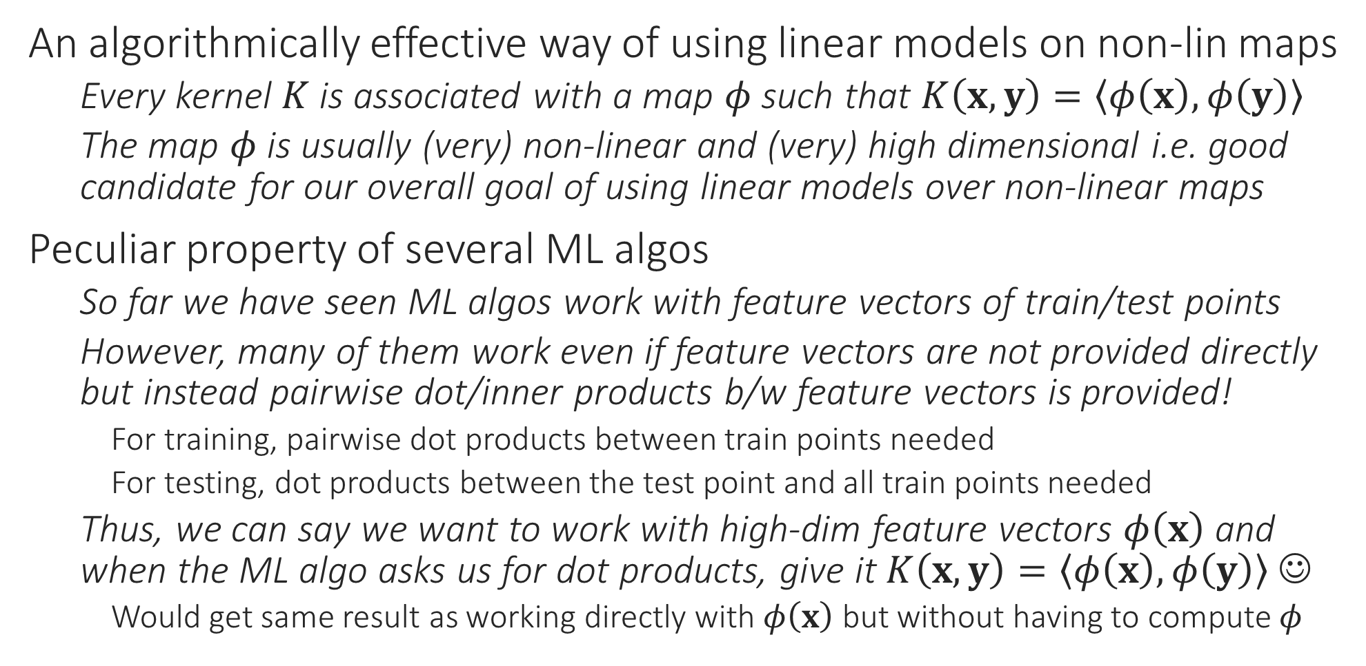
The Kernel Trick
An algorithmically effective way of using linear models on non-lin maps
Every kernel $K$ is associated with a map $φ$ such that $K\left(x,y\right)=\left\langle φ\left(x\right),φ\left(y\right)\right\rangle$
The map $φ$ is usually (very) non-linear and (very) high dimensional i.e. good candidate for our overall goal of using linear models over non-linear maps
Peculiar property of several ML algos
So far we have seen ML algos work with feature vectors of train/test points
However, many of them work even if feature vectors are not provided directly but instead pairwise dot/inner products b/w feature vectors is provided!
For training, pairwise dot products between train points needed
For testing, dot products between the test point and all train points needed
Thus, we can say we want to work with high-dim feature vectors $φ\left(x\right)$ and when the ML algo asks us for dot products, give it $K\left(x,y\right)=\left\langle φ\left(x\right),φ\left(y\right)\right\rangle$ ☺
Would get same result as working directly with $φ\left(x\right)$ but without having to compute $φ$
This peculiar property is often called kernelizability. An ML algo is said to be kernelizable if we can show that it works identically if, instead of feature vectors, we supply pairwise train-train and test-train dot products of feature vectors

Slide 23
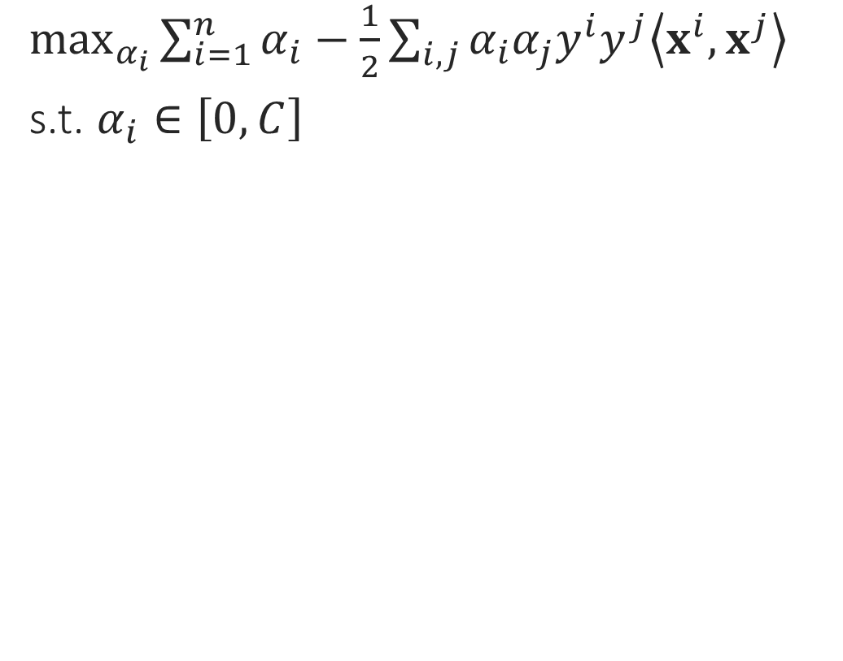
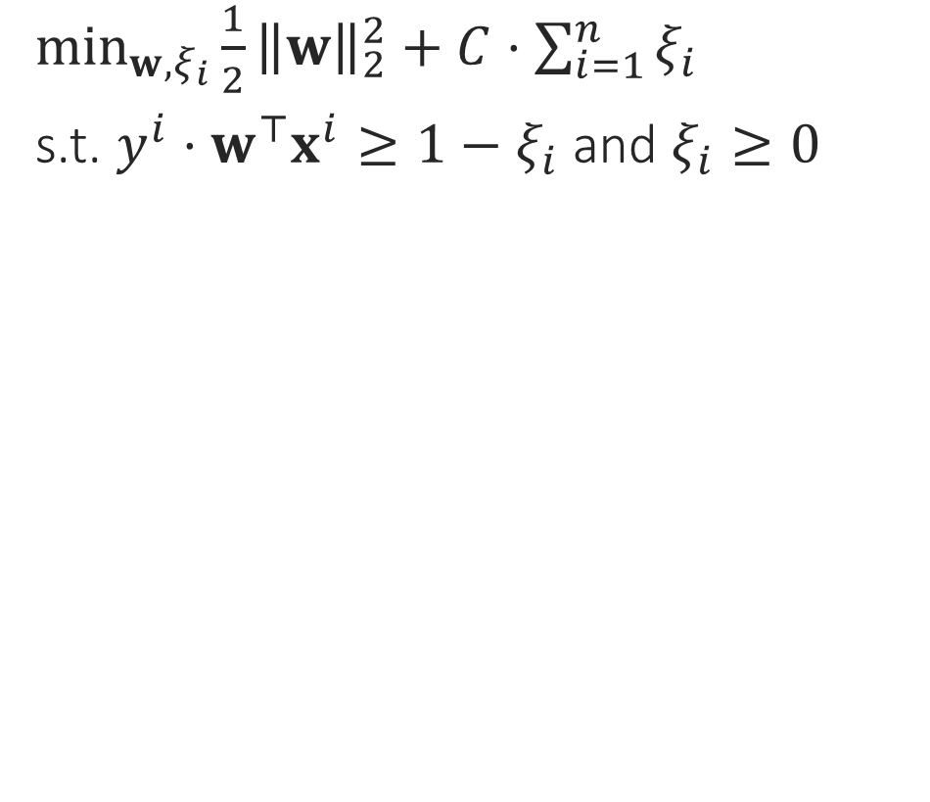
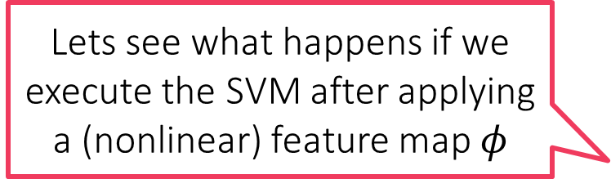
Kernel SVM
Primal formulation
Dual formulation
$\min_{w,ξ_{i}}{\frac{1}{2}{\left\|w\right\|}_{2}^{2}+C⋅\sum_{i=1}^{n}{ξ_{i}}}$
s.t. $y^{i}⋅w^{⊤}x^{i}≥1−ξ_{i}$ and $ξ_{i}≥0$
$\max_{α_{i}}{\sum_{i=1}^{n}{α_{i}}−\frac{1}{2}\sum_{i,j}{α_{i}α_{j}y^{i}y^{j}\left\langle x^{i},x^{j}\right\rangle }}$
s.t. $α_{i}∈\left[0,C\right]$
Lets see what happens if we execute the SVM after applying a (nonlinear) feature map $φ$

Slide 24
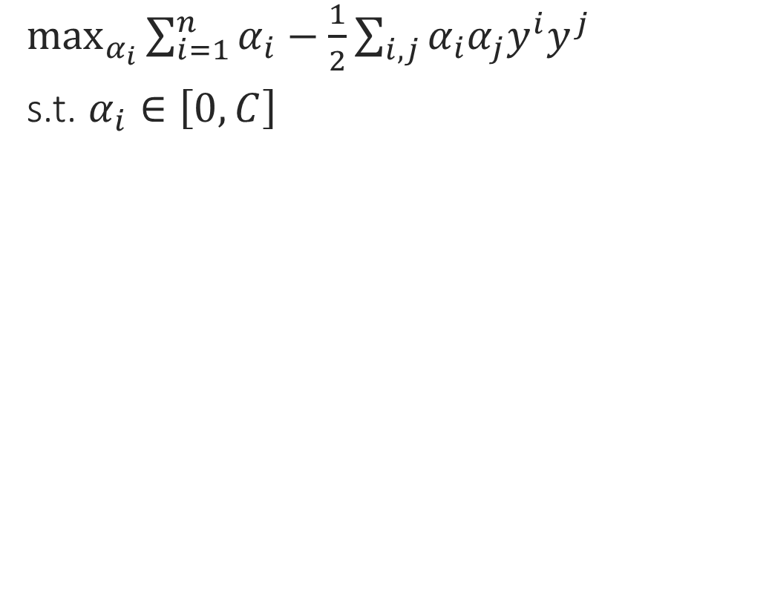
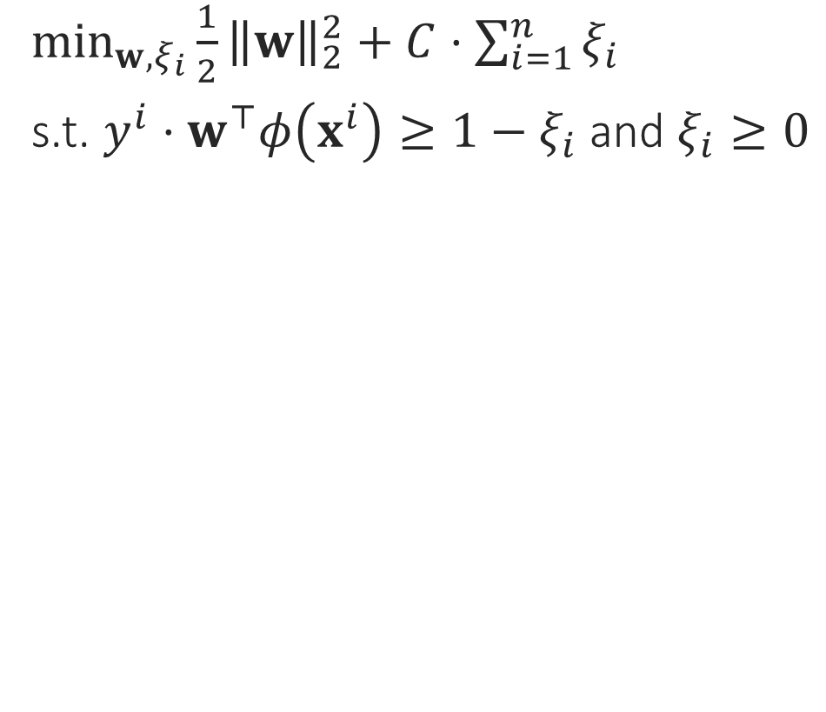
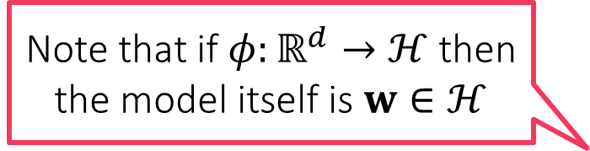
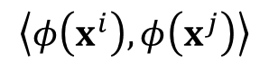
Kernel SVM
Primal formulation
Dual formulation
$\min_{w,ξ_{i}}{\frac{1}{2}{\left\|w\right\|}_{2}^{2}+C⋅\sum_{i=1}^{n}{ξ_{i}}}$
s.t. $y^{i}⋅w^{⊤}φ\left(x^{i}\right)≥1−ξ_{i}$ and $ξ_{i}≥0$
$\max_{α_{i}}{\sum_{i=1}^{n}{α_{i}}−\frac{1}{2}\sum_{i,j}{α_{i}α_{j}y^{i}y^{j}}}$
s.t. $α_{i}∈\left[0,C\right]$
$$\left\langle φ\left(x^{i}\right),φ\left(x^{j}\right)\right\rangle$$
Note that if $φ:ℝ^{d}→ℋ$ then the model itself is $w∈ℋ$

Slide 25
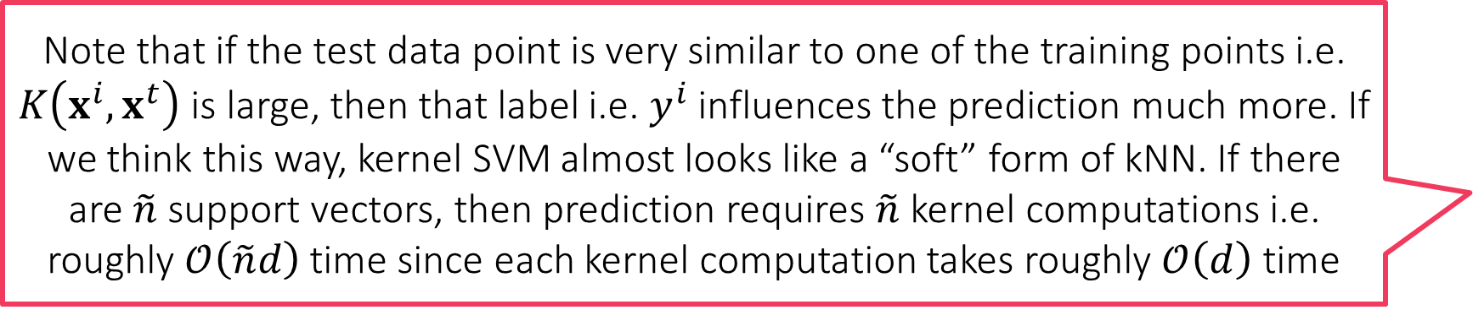
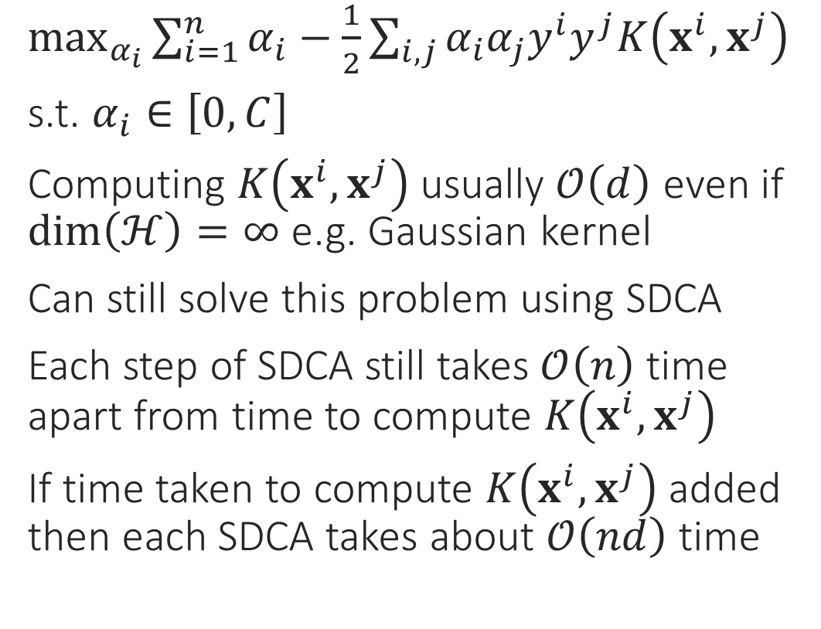
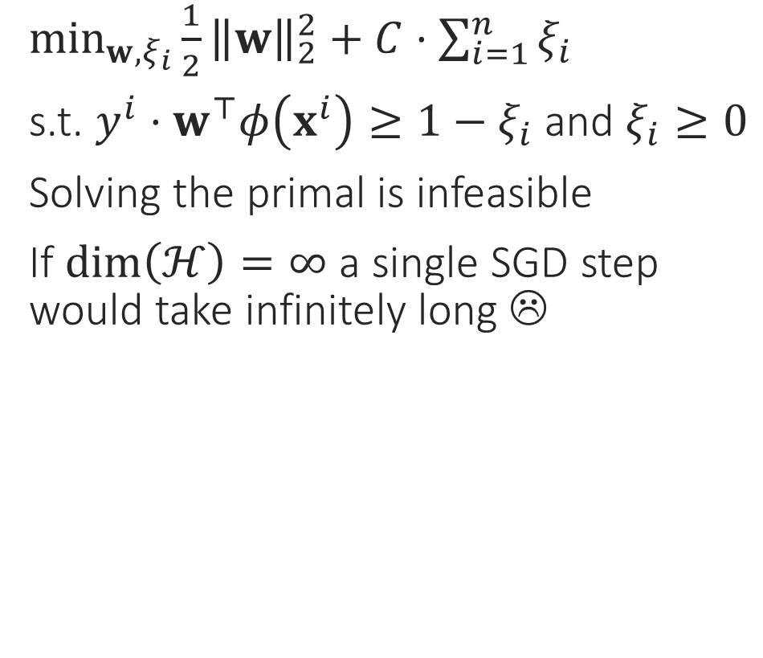
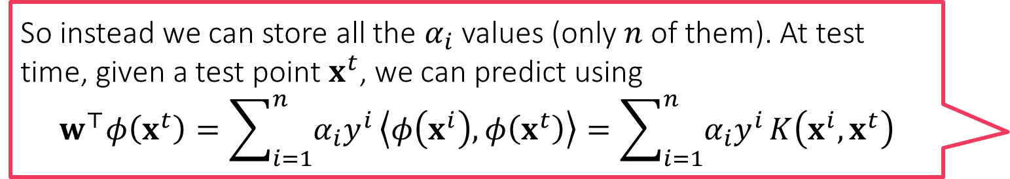
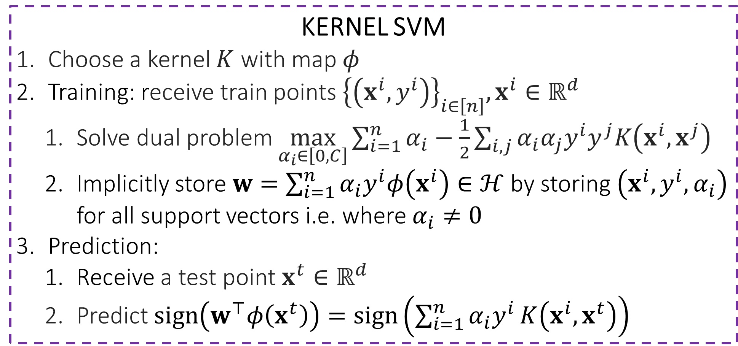
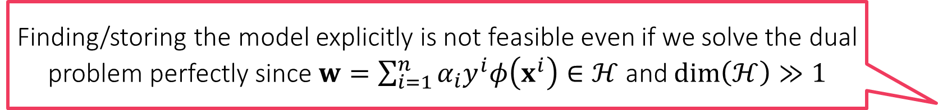
Kernel SVM
Finding/storing the model explicitly is not feasible even if we solve the dual problem perfectly since $w=\sum_{i=1}^{n}{α_{i}y^{i}φ\left(x^{i}\right)}∈ℋ$ and $\dim\left(ℋ\right)≫1$
Primal formulation
Dual formulation
KERNEL SVM
Choose a kernel $K$ with map $φ$
Training: receive train points ${\left\{\left(x^{i},y^{i}\right)\right\}}_{i∈\left[n\right]},x^{i}∈ℝ^{d}$
Solve dual problem $\max_{α_{i}∈\left[0,C\right]}{\sum_{i=1}^{n}{α_{i}}−\frac{1}{2}\sum_{i,j}{α_{i}α_{j}y^{i}y^{j}K\left(x^{i},x^{j}\right)}}$
Implicitly store $w=\sum_{i=1}^{n}{α_{i}y^{i}φ\left(x^{i}\right)}∈ℋ$ by storing $\left(x^{i},y^{i},α_{i}\right)$ for all support vectors i.e. where $α_{i}≠0$
Prediction:
Receive a test point $x^{t}∈ℝ^{d}$
Predict $sign\left(w^{⊤}φ\left(x^{t}\right)\right)=sign\left(\sum_{i=1}^{n}{α_{i}y^{i}}K\left(x^{i},x^{t}\right)\right)$
So instead we can store all the $α_{i}$ values (only $n$ of them). At test time, given a test point $x^{t}$, we can predict using $$w^{⊤}φ\left(x^{t}\right)=\sum_{i=1}^{n}{α_{i}y^{i}}\left\langle φ\left(x^{i}\right),φ\left(x^{t}\right)\right\rangle =\sum_{i=1}^{n}{α_{i}y^{i}}K\left(x^{i},x^{t}\right)$$
$\min_{w,ξ_{i}}{\frac{1}{2}{\left\|w\right\|}_{2}^{2}+C⋅\sum_{i=1}^{n}{ξ_{i}}}$
s.t. $y^{i}⋅w^{⊤}φ\left(x^{i}\right)≥1−ξ_{i}$ and $ξ_{i}≥0$
Solving the primal is infeasible
If $\dim\left(ℋ\right)=∞$ a single SGD step would take infinitely long ☹
$\max_{α_{i}}{\sum_{i=1}^{n}{α_{i}}−\frac{1}{2}\sum_{i,j}{α_{i}α_{j}y^{i}y^{j}K\left(x^{i},x^{j}\right)}}$
s.t. $α_{i}∈\left[0,C\right]$
Computing $K\left(x^{i},x^{j}\right)$ usually $𝒪\left(d\right)$ even if $\dim\left(ℋ\right)=∞$ e.g. Gaussian kernel
Can still solve this problem using SDCA
Each step of SDCA still takes $𝒪\left(n\right)$ time apart from time to compute $K\left(x^{i},x^{j}\right)$
If time taken to compute $K\left(x^{i},x^{j}\right)$ added then each SDCA takes about $𝒪\left(nd\right)$ time
Note that if the test data point is very similar to one of the training points i.e. $K\left(x^{i},x^{t}\right)$ is large, then that label i.e. $y^{i}$ influences the prediction much more. If we think this way, kernel SVM almost looks like a “soft” form of kNN. If there are $\tilde{n}$ support vectors, then prediction requires $\tilde{n}$ kernel computations i.e. roughly $𝒪\left(\tilde{n}d\right)$ time since each kernel computation takes roughly $𝒪\left(d\right)$ time
Training is more expensive, model size is larger, prediction time is more for kernel SVM than was for linear SVM – very typical of non-linear models

Slide 26
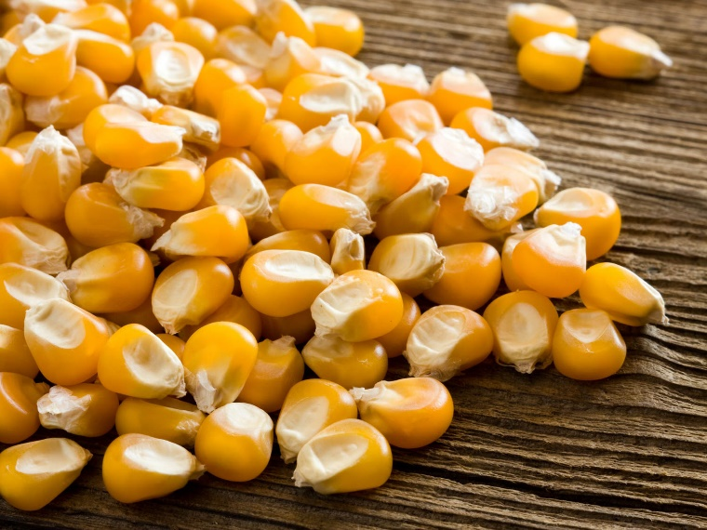
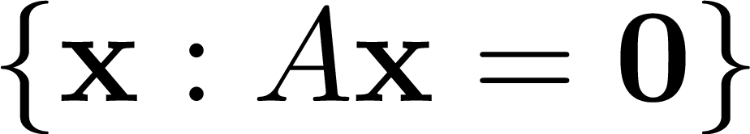

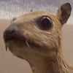
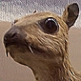
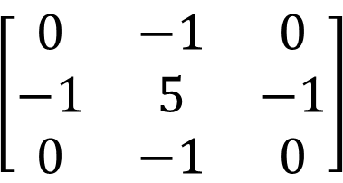
Kernels and Kernels
Kernel of linear transformation
✓
Kernels of corn
$$\left[\begin{matrix}0 & −1 & 0 \\ −1 & 5 & −1 \\ 0 & −1 & 0\end{matrix}\right]$$
Convolution kernels (masks)
OS Kernel

Slide 27



Kernel Ridge Regression
Given data ${\left(x^{i},y^{i}\right)}_{i=1}^{n},x^{i}∈ℝ^{d},y^{i}∈ℝ$, RR solution is simply $\hat{w}={\left(X^{⊤}X+λ⋅I_{d}\right)}^{−1}X^{⊤}y$
Is ridge-regression kernelizable? Does not seem so at first
In fact, it is – by using the dual problem of ridge regression
Deriving the dual for RR: RR solves $\min_{w∈ℝ^{d}}{λ⋅{\left\|w\right\|}_{2}^{2}+{\left\|y−Xw\right\|}_{2}^{2}}$
Dual requires constraints – none here so lets deliberately introduce some!
New (but equivalent) formulation:$\min_{w∈ℝ^{d},z∈ℝ^{n}}{{λ⋅{\left\|w\right\|}_{2}^{2}+\left\|z\right\|}_{2}^{2}}$ s.t. $z=y−Xw$
Lagrangian becomes ${λ⋅{\left\|w\right\|}_{2}^{2}+\left\|z\right\|}_{2}^{2}+α^{⊤}\left(y−Xw−z\right)$
Applying first order optimality gives us $z=α/2$ and $2λ⋅w=X^{⊤}α$
Dual becomes $\min_{α∈ℝ^{n}}{\frac{1}{4λ}⋅\sum_{i,j}{α_{i}α_{j}\left\langle x^{i},x^{j}\right\rangle }+\frac{1}{4}⋅{\left\|α\right\|}_{2}^{2}−α^{⊤}y}$
To handle equality constraints $f\left(x\right)=c$
Method 1: convert to a pair of inequality constraints $f\left(x\right)≤c,f\left(x\right)≥c$
Method 2: use a Lagrangian variable that has no constraints ☺

Slide 28



Kernel Ridge Regression
Note however, that we can use this dual trick to solve RR even in the linear case when $d>n$. Solving linear RR in primal requires $𝒪\left(d^{3}\right)$ time (to invert a $d×d$ matrix) whereas solving linear RR in dual requires $𝒪\left(n^{3}\right)$ time (to invert an $n×n$ matrix). Thus, if $d>n$, dual solution is cheaper
Thus, RR does have a dual problem (that makes it kernelizable too)
Solve $\hat{α}=\underset{α∈ℝ^{n}}{argmin}{\frac{1}{4λ}⋅\sum_{i,j}{α_{i}α_{j}K\left(x^{i},x^{j}\right)}+\frac{1}{4}⋅{\left\|α\right\|}_{2}^{2}−α^{⊤}y}$
Model is $\hat{w}=\frac{1}{2λ}⋅\sum_{i=1}^{n}{\hat{α_{i}}⋅φ\left(x^{i}\right)}∈ℋ$ cannot be stored explicitly
Given a test point $x^{t}$, predict as $\left\langle \hat{w},φ\left(x^{t}\right)\right\rangle =\frac{1}{2λ}⋅\sum_{i=1}^{n}{\hat{α_{i}}⋅K\left(x^{i},x^{t}\right)}$
Some simplifications
Let $G={\left[K\left(x^{i},x^{j}\right)\right]}_{i,j}∈ℝ^{n×n}$ denote the “Gram matrix” of the training points
Dual of kernel RR can be rewritten as $\min_{α∈ℝ^{n}}{\frac{1}{4λ}α^{⊤}\left(G+λ⋅I_{n}\right)α−α^{⊤}y}$
Solution available in closed form $\hat{α}=2λ⋅{\left(G+λ⋅I_{n}\right)}^{−1}y$
Requires inverting $n×n$ matrix (linear RR required inverting $d×d$ matrix)
As before, kernel RR requires more train time, test time and larger model size

Slide 29


Kernel Clustering
Should be relatively simple given our experience with kernel LwP, kNN
All we need to do is kernelize the distance computations and keep track of the cluster centers implicitly since now $μ^{k}∈ℋ$
K-MEANS/LLOYD’S ALGORITHM
Initialize centroids ${\left\{μ^{k}\right\}}_{k=1,…K}∈ℝ^{d}$
For $i∈\left[n\right]$, do cluster assignment, update $z^{i}∈\left[K\right]$ using $μ^{k}$
Let $z^{i}=\arg{\min_{k}{{\left\|x^{i}−μ^{k}\right\|}_{2}^{2}}}$
Update $μ^{k}=\frac{1}{n_{k}}\sum_{i:z^{i}=k}{x^{i}},where n_{k}=\left|\left\{i:z^{i}=k\right\}\right|$
Repeat until convergence

Slide 30


Kernel K-means
Note that cluster centers in k-means are always the average of data points that were assigned to that cluster - $z^{i}$ maintains this info
Need to maintain this information a bit differently for easy processing
Let $α_{i}^{k}=1$ if $z^{i}=k$ and $α_{i}^{k}=0$ if $z^{i}≠k$ i.e. $n_{k}=\sum_{i=1}^{n}{α_{i}^{k}}=1^{⊤}α^{k}$
This lets us write $μ^{k}={\left(\sum_{i=1}^{n}{α_{i}^{k}}\right)}^{−1}⋅\sum_{i=1}^{n}{α_{i}^{k}⋅φ\left(x^{i}\right)}∈ℋ$
Let $G={\left[K\left(x^{i},x^{j}\right)\right]}_{i,j}∈ℝ^{n×n}$ denote the Gram matrix of training points
Using this, we can rewrite distance computations as ${\left\|φ\left(x^{j}\right)−μ^{k}\right\|}_{ℋ}^{2}=K\left(x^{j},x^{j}\right)−2\left\langle μ^{k},φ\left(x^{j}\right)\right\rangle +\left\langle μ^{k},μ^{k}\right\rangle$
where $\left\langle μ^{k},φ\left(x^{j}\right)\right\rangle ={\left(\sum_{i=1}^{n}{α_{i}^{k}}\right)}^{−1}⋅\sum_{i=1}^{n}{α_{i}^{k}⋅K\left(x^{i},x^{j}\right)}={\left(1^{⊤}α^{k}\right)}^{−1}G_{j}^{⊤}α^{k}$ ($G_{j}$ is j-th column of $G$) and $\left\langle μ^{k},μ^{k}\right\rangle ={\left(\sum_{i=1}^{n}{α_{k}^{i}}\right)}^{−2}⋅\sum_{i,j=1}^{n}{α_{i}^{k}α_{j}^{k}K\left(x^{i},x^{j}\right)}$ which is nothing but ${\left(1^{⊤}α^{k}\right)}^{−2}{\left(α^{k}\right)}^{⊤}Gα^{k}$
KERNEL K-MEANS
Initialize ${\left\{α^{k}\right\}}_{k=1,…K}∈{\left\{0,1\right\}}^{n}$ randomly
For $i∈\left[n\right]$, do cluster assignment
Let $n_{k}=1^{⊤}α^{k}$
Let $z^{i}=\arg{\min_{k}{ n_{k}^{−2}⋅{\left(α^{k}\right)}^{⊤}Gα^{k}−2}}n_{k}^{−1}⋅G_{i}^{⊤}α^{k}$
For $k∈\left[K\right]$ update $α^{k}$
For $i∈\left[n\right]$, set $α_{i}^{z^{i}}=1$ and $α_{i}^{l}=0$ for all $l≠z^{i}$
Repeat until convergence

Slide 31






Kernel PCA
Non-linear principal component – much better fit!
Principal component given by PCA/PPCA
$$x=t \\ y=2⋅t^{2}+t^{3}$$
Use $K_{poly}$ with $p=3,c=1$
This data can actually be explained using a single variable! Even though the data looks 2D, it is inherently 1D in a nonlinear way. Kernel PCA can recover this hidden structure

Slide 32




Kernel PCA
Non-linear principal component – much better fit!
Did not do dim-redn but explained data much better!
Principal component given by PCA/PPCA
$$x^{2}+4y^{2}=1$$
$$x^{2}=t \\ y^{2}=r$$
Even this data can actually be explained using a single variable! Even though the data looks 2D, it is inherently 1D in a nonlinear way. Kernel PCA can recover this hidden structure
Use $K_{quad}$

Slide 33


Kernel PCA
This means $M$ has only atmost $n$ eigenfunctions with non-zero eigenvalues i.e. we should be able to write $M$ as $M=\sum_{i=1}^{n}{λ_{i}⋅v^{i}{\left(v^{i}\right)}^{⊤}}$ where $v^{i}∈ℋ$ and $Mv^{i}=λ_{i}⋅v^{i}$ and ${\left(v^{i}\right)}^{⊤}v^{j}=0$ for $i≠j$ and ${\left\|v^{i}\right\|}_{ℋ}=1$ for all $i$
Recall PCA found leading eigenvectors of matrix $S=\frac{1}{n}\sum_{i=1}^{n}{x^{i}{\left(x^{i}\right)}^{⊤}}$
Kernel PCA simply does the same for $M=\frac{1}{n}\sum_{i=1}^{n}{φ\left(x^{i}\right)φ{\left(x^{i}\right)}^{⊤}}$
Notion of matrices does not make sense in $∞$-dimensional settings so we instead talk about operators which are linear maps from $ℋ→ℋ$
Recall that every matrix uniquely corresponds to a linear map so this does make sense
Thus, instead of thinking about $M$ as an $∞×∞$ matrix, think about it as a linear map that takes any vector $h∈ℋ$ and maps it linearly to another vector $Mh∈ℋ$ as $Mh=\frac{1}{n}\sum_{i=1}^{n}{φ\left(x^{i}\right)φ{\left(x^{i}\right)}^{⊤}}h=\frac{1}{n}\sum_{i=1}^{n}{\left(φ{\left(x^{i}\right)}^{⊤}h\right)⋅φ\left(x^{i}\right)}$
Instead of a matrix having eigenvectors and eigenvalues, an operator has eigenfunctions and eigenvalues (possibly infinitely many eigenpairs)
However, our operator $M$ is rank $n$ where $n$ is the number of training points
Try to convince yourself of this in a toy setting where $φ\left(x\right)∈ℝ^{D}$ where $D≫1$ but finite

Slide 34


Executing PCA in an RKHS $ℋ$
For sake of gaining intuition, consider a kernel $K$ whose map $φ$ is very large dimensional but still maps to a finite dimensional space $ℋ=ℝ^{D}$
If $Φ={\left[φ\left(x^{1}\right),…,φ\left(x^{n}\right)\right]}^{⊤}∈ℝ^{n×D}$ then $M=\frac{1}{n}Φ^{⊤}Φ=\frac{1}{n}\sum_{i=1}^{n}{φ\left(x^{i}\right)φ{\left(x^{i}\right)}^{⊤}}$
We wish to kernelize PCA i.e. find an implicit representation for eigenfunctions
If $v∈{ℋ=ℝ}^{D}$ is an eigenfunc of $M$ i.e. $Mv=λ⋅v$, then we can write $v$ as $v=\frac{1}{λ}⋅Mv=\sum_{i=1}^{n}{α_{i}⋅φ\left(x^{i}\right)}$ where $α_{i}=\frac{1}{λn}φ{\left(x^{i}\right)}^{⊤}v$ for $i∈\left[n\right]$
We can rewrite this as $v=Φ^{⊤}α$
This is exactly what we wanted – a way to represent $v$ as linear comb of $φ\left(x^{i}\right)$
What kernel PCA does is instead of searching for eigenfuncs $v∈ℋ$, search for coefficient vectors $α∈ℝ^{n}$
However, a few more steps still required to do so

Slide 35

Executing PCA in an RKHS $ℋ$
See the course notes for a more detailed derivation
Goal: find $α∈ℝ^{n}$ such that $v=Φ^{⊤}α$ is an eigenfunc of $M=\frac{1}{n}Φ^{⊤}Φ$
Rewrite $Mv=λ⋅v$ as $Φ^{⊤}ΦΦ^{⊤}α=λn⋅Φ^{⊤}α$
Still not in proper form since $Φ^{⊤}∈ℝ^{D×n}$ i.e. it is impossibly large dimensional
Recall that $G=ΦΦ^{⊤}$ is the Gram matrix of the training points
Multiplying both sides by $Φ$ gives $ΦΦ^{⊤}ΦΦ^{⊤}α=λnΦΦ^{⊤}α$ i.e. $G^{2}α=λn⋅Gα$
Easy to see that eigenvectors of $G$ will always satisfy the above equation
Slightly more careful argument required to show that the top eigenvectors of $G$ will offer the largest values of $λ$ – easy to see when $G$ is invertible
So, in order to find $v$, all we need to do is apply power + peeling method to obtain the top $k$ eigenpairs of $G$ in time $𝒪\left(kn^{2}\right)$
Contrast this with linear PCA which took only $𝒪\left(kd^{2}\right)$ time, yet again, the price of non-linearity. Model size for kernel PCA also larger $𝒪\left(kn\right)$ for $k$ components

Slide 36


Executing PCA in an RKHS $ℋ$
Note however, that unlike PCA where we could only have $k≤d$, here we can have $k$ as large as $n$. Thus, whereas these new representations are indeed “low-dimensional” in the RKHS, the are not necessarily low-dimensional in the original space of i.e. we may still have $k>d$ if $n>d$
Perform PCA on Gram matrix $G$ to obtain an eigenpair $(\tilde{λ},α)$
This (implicitly) gives us the eigenfunctions of $M$ as $Φ^{⊤}α$
Need to normalize the eigenfunction though since we may have ${\left\|Φ^{⊤}α\right\|}_{ℋ}≠1$
Find ${\left\|Φ^{⊤}α\right\|}_{ℋ}^{2}=α^{⊤}Gα=\tilde{λ}$ and use $v=\frac{1}{\sqrt{\tilde{λ}}}⋅Φ^{⊤}α$ as eigenfunction of $M$
We can also obtain new representations for data using kernel PCA
In linear PCA we simply used $W^{⊤}x$ as the new (low-dim) representation
Kernel PCA also offers a new $k$-dim rep if we find $k$ eigenfuncs $v^{1},…,v^{k}∈ℋ$ using $k$ eigenvectors $α^{1},…,α^{k}∈ℝ^{n}$ of $G$
Given a new point $x$ compute $z∈ℝ^{k}$ where $z_{i}=\left\langle v^{i},φ\left(x\right)\right\rangle =\frac{1}{\sqrt{{\tilde{λ}}_{i}}}⋅\sum_{j=1}^{n}{α_{j}^{i}⋅K\left(x,x^{j}\right)}$

Slide 37

A note on data centering
Recall that PCA performs well when data is mean centered since PCA fits a hyperplane that passes through the origin to the data
Need to mean center data for kernel PCA as well for good performance
As before, all this needs to be done implicitly
Mean of data in RKHS is $μ=\frac{1}{n}⋅\sum_{i=1}^{n}{φ\left(x^{i}\right)}$. We should perform all operations with mean centered data i.e. $φ\left(x^{i}\right)−μ$
Since all we need to perform kernel PCA is the Gram matrix, need to find out what does the Gram matrix look like for the new centred data i.e. $\tilde{G}=\left[{\tilde{G}}_{ij}\right],{\tilde{G}}_{ij}=\left\langle φ\left(x^{i}\right)−μ,φ\left(x^{j}\right)−μ\right\rangle$
Turns out this is available in closed form ($1=\left[1,…,1\right]∈ℝ^{n}$) $\tilde{G}=\left(I_{n}−\frac{{11}^{⊤}}{n}\right)G\left(I_{n}−\frac{{11}^{⊤}}{n}\right)$
Simply use $\tilde{G}$ in all kernel PCA operations

Slide 38


Kernel PCA
KERNEL PCA
Data points $x^{1},…,x^{n}∈𝒳$, #components $k≤n$
Find centered Gram matrix $\tilde{G}=\left(I_{n}−\frac{{11}^{⊤}}{n}\right)G\left(I_{n}−\frac{{11}^{⊤}}{n}\right)$
Find $k$ largest eigenvectors/values of $\tilde{G}$ as ${\left(λ_{j},α^{j}\right)}_{j=1,…,k}$
Let $A=\left[α^{1},…,α^{k}\right]∈ℝ^{n×k}$ and $Λ=diag\left(λ_{1},…,λ_{k}\right)∈ℝ^{k×k}$
For a point $x∈𝒳$, find $k$-dim representation
Let $k^{x}∈ℝ^{n}$ such that $k_{i}^{x}=K\left(x^{i},x\right)$
Return $z=\sqrt{Λ^{−1}}A^{⊤}k^{x}∈ℝ^{k}$
Whereas PCA could return only $k≤d$ components, KPCA can return upto $k≤n$ components – more data, more possible components!

Slide 39

Accelerated Kernel Learning
Kernelized versions of algos can be much slower than linear versions
Training typically done in a “dual” form since “primal” forms inaccessible
Updates slower e.g. each step of SDCA takes $𝒪\left(n\right)$ kernel computations i.e. $𝒪\left(nd\right)$ time
Model size typically grows as training dataset size $n$ increases
Kernel SVM: #SV can be as large as $n$ in which case all train data has to be stored
Kernel RR/PCA: entire training data $n$ has to be stored in general anyway
Prediction time also goes up – upto $𝒪\left(n\right)$ kernel computations i.e. $𝒪\left(nd\right)$ time
Kernel methods are examples of non-parametric ML algorithms
Name is misleading: an ML algo is called non-parametric if the #params in its model can grow in an unbounded manner as train set sizes increases
Contrast this with linear SVM/RR/LwP where the model has only $𝒪\left(d\right)$ parameters ($d$-dim vectors) irrespective of how large (or small) $n$ is – these are called parametric ML algos
Even non kernel algos can be non-parametric e.g. vanilla (non-kernel) kNN

Slide 40
Accelerated Kernel Learning
Several techniques exist to speedup kernel algorithms – these can be grouped into three main families
Presented using kernel SVM as example – can be applied to kernel RR/PCA too
Post-processing: learn the kernel SVM model (will be a bit costly) but then compress the model to make storage/prediction cheaper
Approximate training: directly learn a kernel SVM model that is cheap to store and predict
Kernel approximation: use a kernel different than the one we originally wanted but choose this new kernel so that it
Provides approximately the same kernel values as the original one
Results in models that are cheap to store and predict

Slide 41

Post Processing
Learn kernel SVM, support vectors $\{x_{i_{j}},α_{i_{j}}\}$
Find a reduced set of $k≪\tilde{n}$ support vectors $\left\{{\tilde{x}}_{i_{1}},…,{\tilde{x}}_{i_{k}}\right\}$ e.g. by using k-means clustering in original space i.e. $ℝ^{d}$
Re-compute $α$ values for these reduced set support vectors e.g. by running SVM again on $\left\{{\tilde{x}}_{i_{1}},…,{\tilde{x}}_{i_{k}}\right\}$
Burges and Scholkopf, Improving the Speed and Accuracy of SVMs, NIPS 1996.
Cossalter et al. Adaptive Kernel Approximation for Large-Scale Non-Linear SVM Prediction, ICML 2011.

Slide 42

Approximate Training
Kernel SVMs always use support vectors that are a subset of train data
Maybe removing this restriction can reduce their number?
Learn support vectors as well (that are not necessarily training points)
Given budget $k$ on how many SV we are allowed (based on space/time)
Learn $z^{1},…,z^{k}∈ℝ^{d}$ and $α_{1},…,α_{k}∈ℝ$ so that $w={\sum_{i=1}^{k}{α}}_{i}⋅φ\left(z^{i}\right)∈ℋ$ is a good model for our learning task
Reduces model size and prediction time to $O\left(kd\right)$ where we can control $k$
No free lunch: training problem becomes much more difficult – not a convex problem anymore ☹
Joachims and Yu. Sparse Kernel SVMs via Cutting-Plane Training, Machine Learning 76(2):179-193, 2009
Tsang et al. Core Vector Machines, JMLR 6:363-392, 2005

Slide 43

Kernel Approximation - Landmarking
Given a training set $S=\left\{x^{1},…,x^{n}\right\}⊂ℝ^{d}$ and a kernel $K$
Based on budget, Identify $k$ train points $\left\{{\hat{x}}^{1},…,{\hat{x}}^{k}\right\}$ (e.g. clustering, randomly)
Represent every other point (train/test) in terms of their similarity to these prototypes where similarity is given by the kernel $K$ $\hat{φ}\left(x\right)=\left[K\left(x,{\hat{x}}^{1}\right),…,K\left(x,{\hat{x}}^{k}\right)\right]∈ℝ^{k}$
Treat $\hat{φ}$ as a new feature representation and use it in ML algos
If $k$ is reasonably small, can use linear SVM/RR/PCA on new features directly
Offers $O\left(k\right)$ model size and $O\left(dk\right)$ prediction time where we can control $k$
Can be shown mathematically that if $K$ was nice for the problem (e.g. gave us small classification/regression error), then so will $\hat{φ}$
Balcan and Blum. On a Theory of Learning with Similarity Functions, ICML 2006.
K. and Jain. Similarity-based Learning via Data driven Embeddings, NIPS 2011.

Slide 44

Kernel Approximation – Nystrom Method
Close cousin of landmarking – removes redundancy in landmarks
Suppose we have chosen $k$ landmarks $\left\{{\hat{x}}^{1},…,{\hat{x}}^{k}\right\}⊂S$. Let $G=UΛU^{⊤}$ be the Gram matrix of these landmarks w.r.t kernel $K$ and its (thin) eigendecomp.
As before, define the landmarked feature map $\hat{φ}\left(x\right)=\left[K\left(x,{\hat{x}}^{1}\right),…,K\left(x,{\hat{x}}^{k}\right)\right]$ but instead use $\tilde{φ}\left(x\right)=\sqrt{Λ^{−1}}U^{⊤}\hat{φ}\left(x\right)$ ($Λ^{−1}$ exists since we chose thin ED)
Another interpretation – landmarking effectively asks us to use the kernel $\hat{K}\left(x,y\right)=\hat{φ}{\left(x\right)}^{⊤}\hat{φ}\left(y\right)$ whereas Nystrom effectively asks us to use the kernel $\tilde{K}\left(x,y\right)=\tilde{φ}{\left(x\right)}^{⊤}\tilde{φ}\left(y\right)=\hat{φ}{\left(x\right)}^{⊤}G^{†}\hat{φ}\left(y\right)$
Suppose we cheated and chose ${\hat{x}}^{1}=…={\hat{x}}^{k}$ (i.e. same landmark)
Nystrom method will detect this since $G$ will be rank 1 and so $\tilde{φ}\left(x\right)∈ℝ^{1}$
Williams et al. Using Nystrom Method to Speed Up Kernel Machines, NIPS 2000
Yang et al. Nystrom Method vs Random Fourier Features, NIPS 2012

Slide 45

Kernel Approximation – Explicit Features
Kernels use high/infinite dim feature maps – root of all problems
Can we get finite (small) dim feature maps that approx. the kernel value?
Given a kernel $K$ over a domain $𝒳$ and budget $k$, find a map $\overline{φ}:𝒳→ℝ^{k}$ s.t. $K\left(x,y\right)≈\left\langle \overline{φ}\left(x\right),\overline{φ}\left(y\right)\right\rangle$
If such maps exist then we can simply execute linear SVM/RR/PCA with $\overline{φ}\left(x\right)$
Will get performance similar to what using $K$ directly with kernel SVM/RR/PCA would have given but now with only $𝒪\left(k\right)$ model size, $𝒪\left(dk\right)$ prediction time
Note that landmarking/Nystrom do not seek to approximate kernel values
Why should such kernel approximating maps even exist?
We call a kernel $K$ a rank-$r$ kernel if its feature map $φ_{K}:𝒳→ℝ^{r}$
Several popular kernels (poly, Gaussian, Laplacian) have a funny property that they can be expressed as an average (expectation) of rank-1 kernels
Several techniques exploit this property to construct such maps

Slide 46

Kernel Approximation – Explicit Features
Specifically, several popular kernels can be written as $K\left(x,y\right)=𝔼_{ω}\left[K_{ω}\left(x,y\right)\right]$
where $ω∼𝒟_{K}$ where $𝒟_{K}$ is a distribution specific to $K$ (typically over $ℕ,ℝ^{d}$)
For every $ω$, $K_{ω}\left(x,y\right)$ is rank 1 i.e. $φ_{ω}:𝒳→ℝ$ and $K_{ω}\left(x,y\right)=φ_{ω}\left(x\right)⋅φ_{ω}\left(y\right)$
Such results are often classical e.g. Bochner’s theorem, Schoenberg’s theorem
Exploiting such a result is straightforward – sample $ω_{1},…ω_{k}∼𝒟_{K}$ and let $\overline{φ}\left(x\right)=\frac{1}{\sqrt{k}}⋅\left[φ_{ω_{1}}\left(x\right),…,φ_{ω_{k}}\left(x\right)\right]∈ℝ^{k}$
For example, for the Gaussian kernel, Bochner’s theorem tells us that $K\left(x,y\right)=𝔼_{ω}\left[\cos\left(ω^{⊤}x\right)⋅\cos\left(ω^{⊤}y\right)\right]$ where $ω∼𝒩\left(0,I_{d}\right)$ i.e. $ω∈ℝ^{d}$ and $φ_{ω}:x↦\cos\left(ω^{⊤}x\right)$
Several papers mathematically show that $K\left(x,y\right)≈\left\langle \overline{φ}\left(x\right),\overline{φ}\left(y\right)\right\rangle$

Slide 47
Kernel Approximation – Explicit Features
Feature constructions for Gaussian/Laplacian, intersection, poly kernels
Rahimi and Recht, Random Features for Large Scale Kernel Machines, NIPS ‘07
Maji and Berg, Max-margin Additive Classifiers for Detect, ICCV 2009
K. and Karnick. Random Feature Maps for Dot Product Kernels. AISTATS 2012
Other interesting approaches to kernel approximation exist too
Use decision trees to compute similarity between two points and use that as kernel – extremely fast prediction
Jose et al. Local Deep Kernel Learning, ICML 2013.
Learn these kernel approximations in a task-dependent manner
Perronnin et al. Large-scale Image Categorization with Explicit Data Embedding, CVPR 2010.

